Slide 1
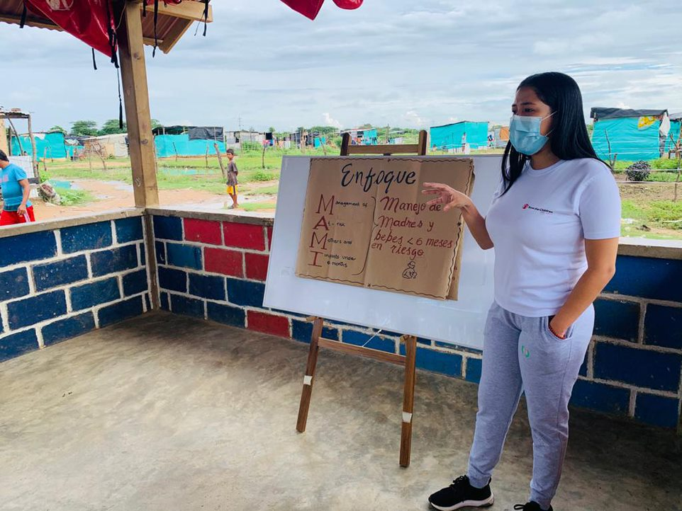


MAMI Care Pathway Workshop: Contextualization to
[country/region/organization]
Notes:
IMPORTANT – IF YOU HAVE NOT FACILITATED THE MAMI CARE PATHWAY ORIENTATION TO THE WORKSHOP PARTICIPANTS, PLEASE DO THIS BEFORE THE CONTEXTUALISATION WORKSHOP, WHICH IS PART 2.

Slide 2
Objectives
The objectives of the workshop session are:
To become familiar with applying the MAMI Care Pathway
To adapt the MAMI Care Pathway Package to the [COUNTRY] context
Content Hub: CH1304412

Slide 3
AGENDA
Time | Session
5 minutes | Welcome & Objectives
45 minutes | Recap
60 minutes | Contextualizing the MAMI Assessment
20 minutes | Break
60 minutes | Who, What, Where
45 minutes | Monitoring, Evaluation and Learning
15 minutes | Q & A
4 hours
Content Hub: CH1304412

Slide 4

Activity
Applying the MAMI Care Pathway
15 minutes
Using the following scenario:
GROUP 1: Scenario A
GROUP 2: Scenario B
GROUP 3: Scenario C
GROUP 4: Scenario D
Apply the MAMI materials to the cases and discuss the following:
  What is the management plan?
  Did the materials and pathway help?
  Is there any overlap between these materials and what you currently use? Any additional content in these materials that are not in your current materials?
Notes:
4 Groups (same as day 1 if possible). Group work: 15 minutes. Feedback: 30 minutes.
Instructions for Group Activity:
Back into same groups to revisit the case scenario (handout: Group Work_Existing Protocols_Scenarios Handout)
Reflect on management plan and identify what would be done differently
Apply the MAMI materials to the cases and discuss the following:
1. Is there anything different about the management plan and if so what?
2. Are you comfortable with using the materials? Are any of the forms or pathways not clear?
3. Did the materials and pathway help?
4. Is there any overlap they see between these materials and what they currently use? Any additional content in these materials that are not in their current materials?
30 minutes to discuss
1 person to make notes to present back.
Instructions for Plenary:
Each group to present back
Note the differences and the overlaps in 2 columns on the flipchart
Open discussion at the end

Slide 5
Recap
QUICK QUIZ!
Who is the focus on for MAMI?
What factors are assessed and supported during the MAMI Care Pathway?

Slide 6
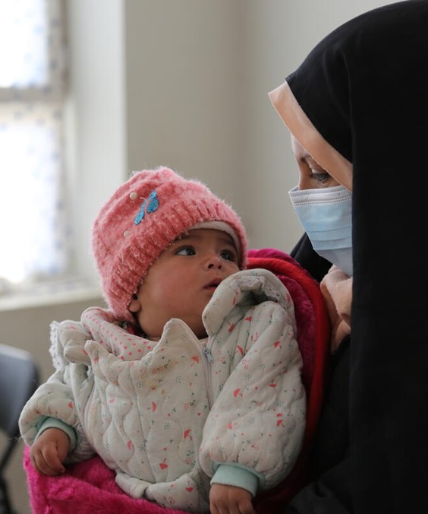

THE MAMI CARE PATHWAY IN [CONTEXT]

Slide 7
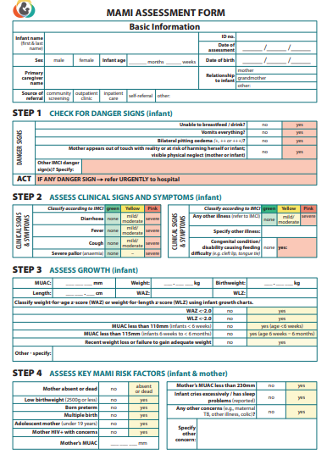
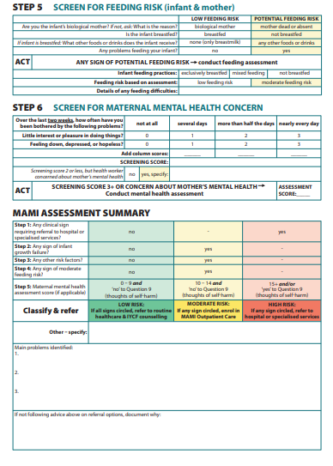
Screening & Assessment
MAMI Assessment
Content Hub: CH1304412
Notes:
DO: Handout a copy of the assessment form, feeding form, maternal mental health form to all participants
SAY: This is a 2 page assessment form of the mother and infant that assesses those 5 components of nutritional risk that we introduced previously
SAY: There are 6 steps covering the different areas that underlie the risk status of the infant <6 months. We will go through each one in detail now.

Slide 8
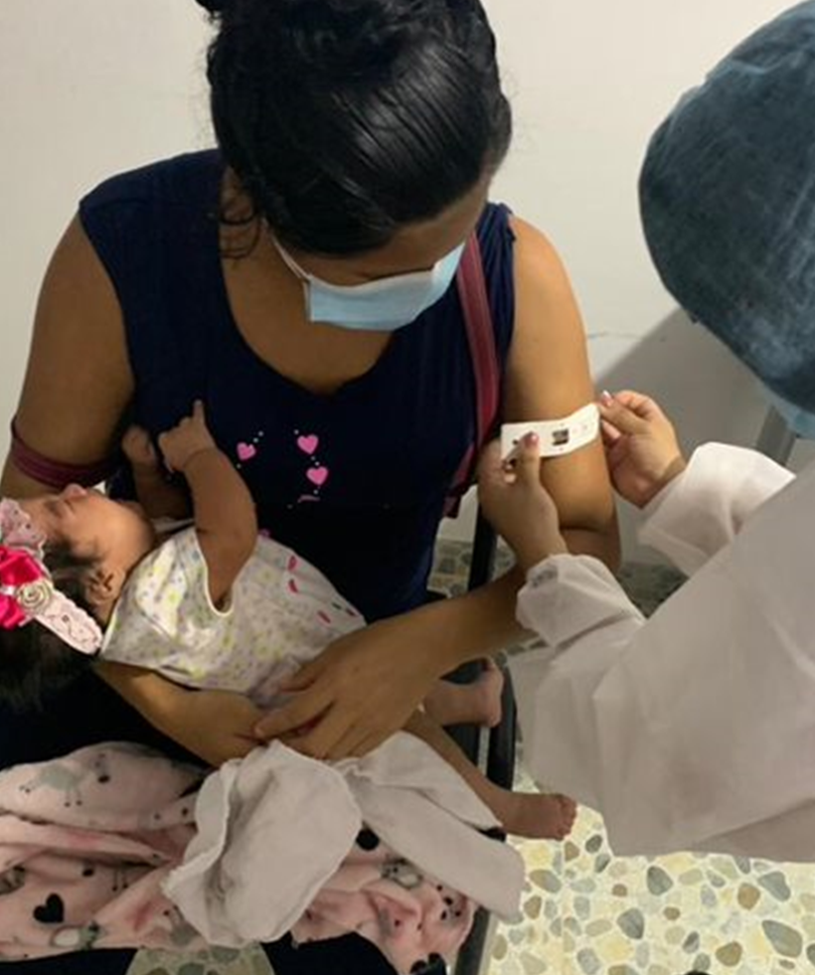
Contextualizing the MAMI Assessment

Slide 9

Nutritional Risk in infants u6m
Assessment of nutritional risk
INFANT’S NUTRITIONAL STATUS
INFANT’S
CLINICAL STATUS
MAMI RISK FACTORS
MOTHER’S
MENTAL HEALTH
FEEDING PRACTICES
Content Hub: CH1304412
Notes:
SAY:
Remember in the orientation we discussed how the nutritional risk status in infants less than 6 months and their mothers was assessed using these 5 components. The MAMI Assessment is shaped around these 5 areas.
Lets take a look at the assessment step by step..

Slide 10
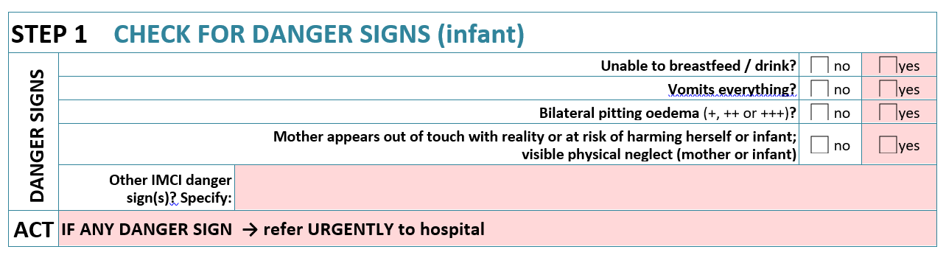
The MAMI Assessment
Step 1: Check for Danger Signs
Content Hub: CH1304412
Notes:
SAY: Step 1 is check for danger signs.
ASK: Why do you think this may be the first step?
Answer: we need to know if there are any danger signs of the infant that require urgent referral to hospital/ inpatient care.
SAY: We must check for the key IMCI danger signs, therefore you should refer to the national IMCI guidelines for more details on this part of the assessment.
SAY: In addition to the IMCI danger signs, we also check for ‘MAMI specific danger signs’ which include odema of any grade. Oedema is very rare in infants <6months and is therefore classified as very serious and a sign for urgent referral.
SAY: The other MAMI specific danger sign is any sign of severe mental health illness of mother.
DISCUSS:
Are all of these relevant for the context?
Are there any edits needed to contexualise?
Any concerns with referral criteria to inpatient care (shaded pink)?
Note: facilitator to note down any changes to be made to the word document.

Slide 11
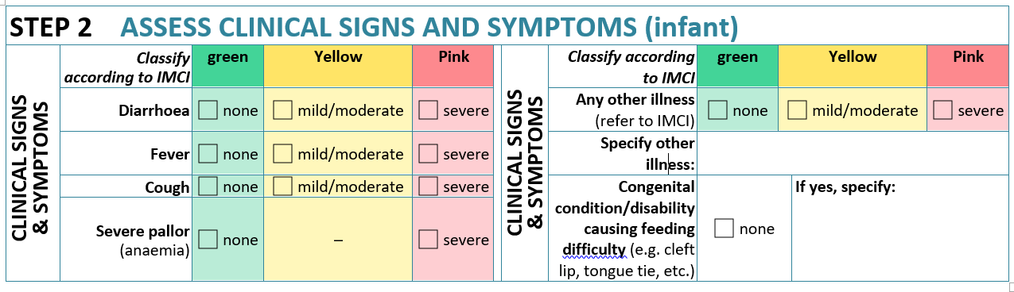
The MAMI Assessment
Step 2: Assess Clinical Signs and Symptoms of Infant
Content Hub: CH1304412
Notes:
Note. IMCI Training is needed for HWs to do this assessment to an appropriate standard. This training only includes a recap.
SAY: Step 2 is to check for clinical signs and symptoms of the infant.
DISCUSS
Are all relevant?
Any concerns with any of the enrolment criteria (yellow) or referral to inpatient care criteria (red)?
Note: facilitator to note down any changes to be made to the word document.

Slide 12
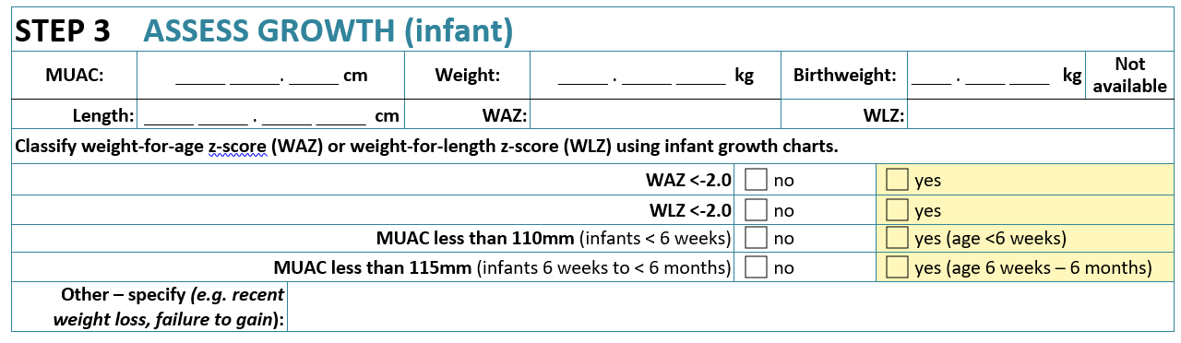
The MAMI Assessment
Step 3: Assess Infant Growth
Content Hub: CH1304412
Notes:
SAY: Step 3 is to assess the infant’s growth.
DISCUSS:
Are all of these relevant for the context?
Are there any edits needed to contexualise?
Are there any concerns with any of the enrolment criteria (shaded in yellow)?
Probe on the use of MUAC for enrolment
Probe on the use of WAZ for enrolment (strongly advised as WAZ is the best measure of risk for infants less than 6 months, but this may require some allignment with national IMAM protocols)
Note: facilitator to note down any changes to be made to the word document.

Slide 13
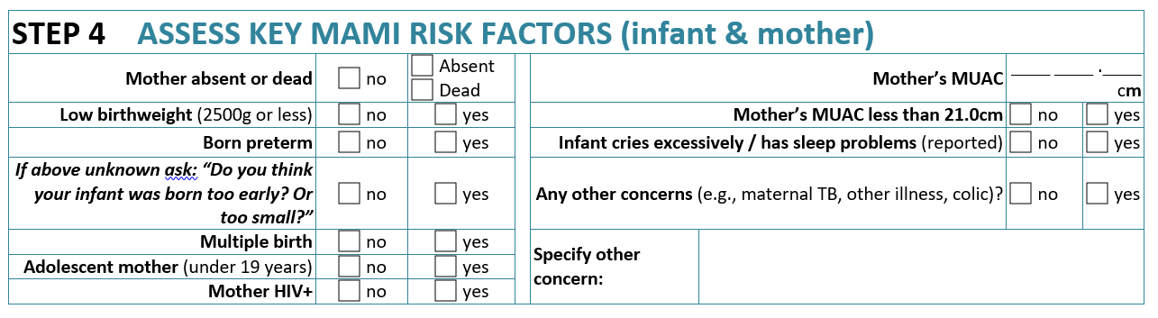
The MAMI Assessment
Step 4: Assess Key MAMI Risk Factors
Content Hub: CH1304412
Notes:
SAY:
Step 4 assess the MAMI Risk Factors – a list of evidence-based risk factors that impact on the infant’s nutritional risk status. These are simple yes/no questions.
Any questions on any of these?
There is a space at the end for ‘any other concerns’ which allows the health worker to use their own judgement for any other reason, which may not be implicitly captured during the assessment, but that you may feel there is a risk to the mother and infant and a need to be enrolled in to the MAMI program for support.
DISCUSS:
Are all of these relevant for the context?
Are there any edits needed to contexualise?
Are there any concerns with any of the enrolment criteria (shaded in yellow)?
Note: facilitator to note down any changes to be made to the word document.

Slide 14
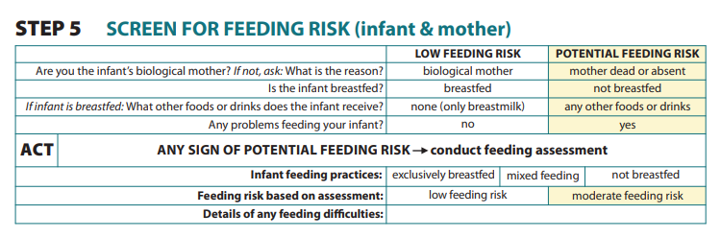
The MAMI Assessment
Step 5: Screen for Feeding Risk
Content Hub: CH1304412
Notes:
SAY:
The MAMI Assessment Form asks basic questions about infant feeding with yes/no answers.
If there are potential feeding risks then complete a full infant feeding assessment – this can be the existing one you use, or the MAMI Feeding assessment in the MAMI Care Pathway Package.
DISCUSS:
Is there an existing feeding screening tool form that you use? If so, should we use that one or continue with this one?
If we use these questions, are there any edits needed to contexualise?
Are there any concerns with any of the enrolment criteria?
Note: facilitator to note down any changes to be made to the word document.

Slide 15
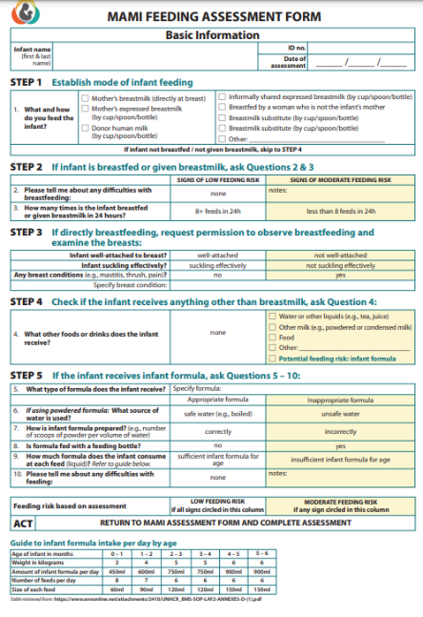
Feeding Risk
Full Feeding Assessment
Content Hub: CH1304412
Notes:
DO: Bring participants attention to the MAMI Feeding Assessment Form.
SAY:
A feeding assessment looks to confirm feeding practices, and to understand any challenges the caregiver may be having in practicing exclusive breastfeeding.
If an infant is being fed with infant formula, the assessment also looks at these practices, identifying practices that may be putting the infant at risk.
ASK:
Is there an existing feeding/IYCF/breastfeeding assessment form that you use? If so, it is better to continue to use the existing form rather than replace it with this one.
If we use this form, are there any edits needed to contexualise?
Note: facilitator to note down any changes to be made to the word document.

Slide 16
The MAMI Assessment
Step 5: Screen for Feeding Risk
Content Hub: CH1304412
Notes:
SAY: Let’s look at the mental health screening in the MAMI Assessment. This is known as the PHQ2.
DO: Bring participants attention to Step 6 on the assessment form: screen for maternal mental health concern and talk through the questions.
SAY:
If the mother scores 3+ then you go on to conduct an in-depth mental health assessment using the Maternal Mental Health Assessment Form, which is called a PHQ9.
Before we move to look at the PHQ9:
Is there an existing mental health screening tool that is being used? Or would we want to use this one?
Are there any edits needed to contexualise?
Note: facilitator to note down any changes to be made to the word document.

Slide 17
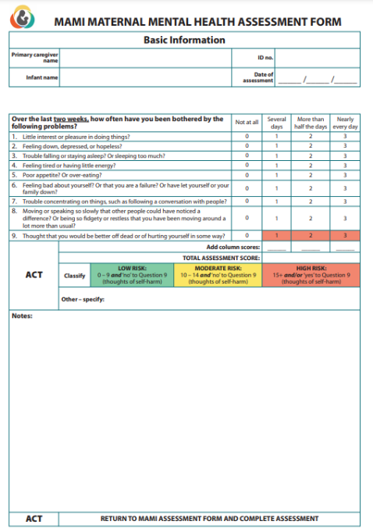
Maternal Mental Health
In depth assessment
Content Hub: CH1304412
Notes:
DO: Bring participants attention to the MAMI Maternal Mental Health Assessment Form.
SAY: This is called the PHQ9. This is the full mental health assessment that can be used, only if needed, for a more detailed assessment of the mother.
DISCUSS:
Is there an existing mental health assessment form that you use? If so, it may be better to continue to use the existing form rather than replace it with this one.
If we use this form, are there any edits needed to contexualise?
Note: facilitator to note down any changes to be made to the word document.

Slide 18
Adapting the MAMI Care Pathway Resources
Tools that require contextualization
MAMI Health Worker Support Materials
  MAMI Assessment Form √
  Feeding Assessment Form √
  Maternal Mental Health Assessment Form √
  Management and Enrolment Form
  MAMI Counselling Cards and Support Actions Booklet
WHO, WHAT, WHERE?
Notes:
SAY:
We have worked through the MAMI Assessment together as an example.
The same process Will need to be applied to the MAMI Management & Enrolment Form
It will also need to be decided whether you want to use all of, some of, or none of the MAMI Counselling Cards & Support Actions booklet
We will now move on to ‘Who, What, Where’

Slide 19
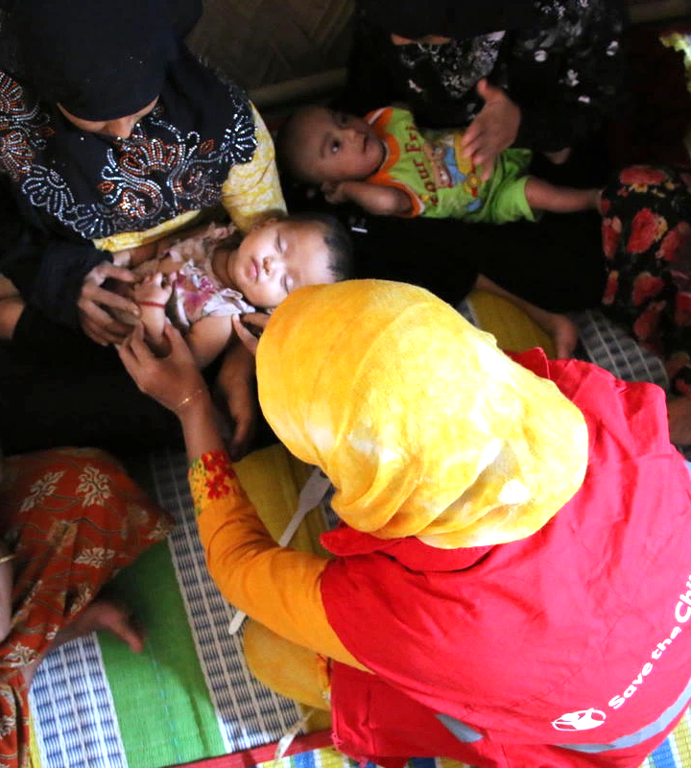
MAMI SCREENING
Save the Children,

Slide 20
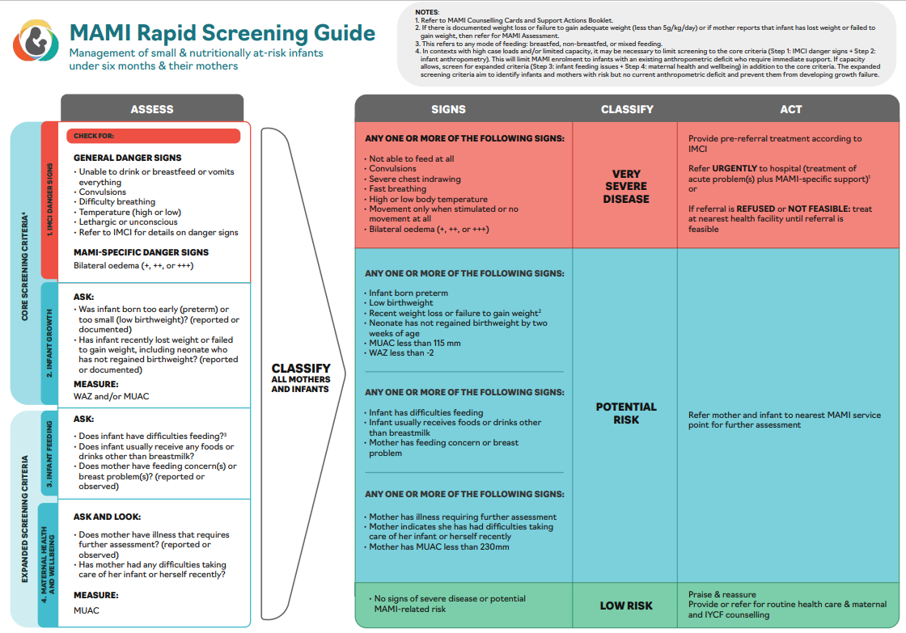
MAMI Screening
Selection of MAMI Screening Criteria
Notes:
DO: Provide Handout_MAMI rapid screening guide
SAY:
This is the MAMI Rapid Screening User Guide
It gives a recommendation for what can be included for a MAMI Screening
Please take 5 minutes to read through
DISCUSS:
Which of these screening criteria do you think are possible in the community?
Which of these screening criteria do you think are possible at a facility e.g. by immunisation nurse, midwife or other key contact point with infants less than 6-months and their mothers?
Note: facilitator to note down responses.

Slide 21
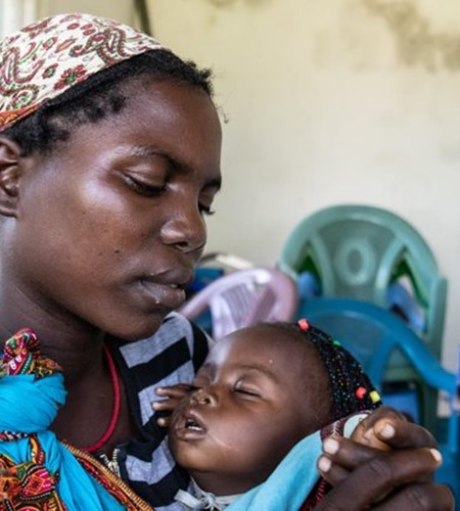
Who?
What?
Where?
Save the Children,

Slide 22
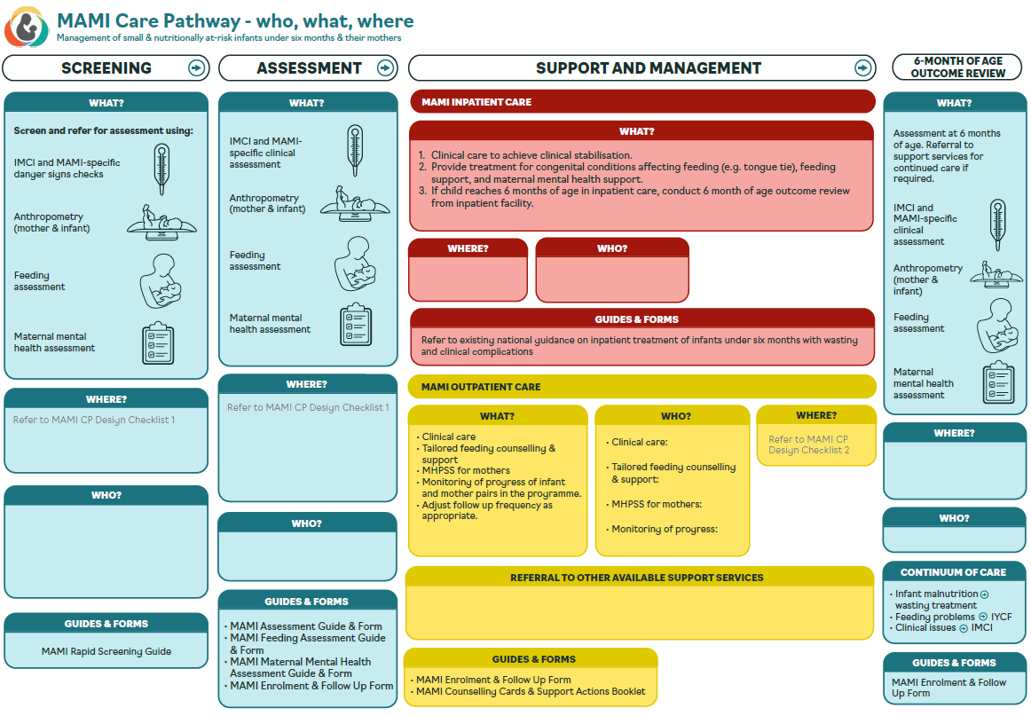
Notes:
SAY:
Now we are more familiar with what is involved in the assessment for MAMI, and thinking back to the orientation we know what support we want to provide or link with for the management of mother-infant pairs that are enrolled, we need to contextualise the MAMI Care Pathway, thinking about WHO, WHAT, WHERE for each stage.
Say:
“We are going to use the template on this slide to brainstorm the various stages of the MAMI Care Pathway, and WHERE and WHO for each stage.”
“The template details WHAT is needed at each stage, with the exception of the intervention. For the intervention we will also need to decide on WHAT support we are able to provide directly, and what support is available to link to.”
“We will take a closer look at each section and have time for discussion on each to complete the template for the Nigerian context.”

Slide 23
Who, What, Where: Contextualizing the MAMI Care Pathway
SCREENING | ASSESSMENT | MANAGEMENT
WHAT? | WHAT? | WHAT?
IMNCI & MAMI-specific danger signs? Child growth failure? Infant feeding risk? Maternal wellbeing risk? Confirm what is feasible for screening (refer to MAMI Screening Guide) | IMNCI & MAMI-specific danger signs IMNCI signs & symptoms Child growth Infant feeding Maternal mental health Confirm that all will be included | INPATIENT CARE Clinical care to achieve clinical stabilisation Provide treatment for congenital conditions affecting feeding, feeding support, and maternal mental health support Mental health services for mother, as required Confirm what is available | OUTPATIENT CARE Counselling on core topics for all enrolled pairs. Tailored counselling and actions to address specific risk factors and problems as required: Clinical care Feeding counselling & support Mental Health and Psychosocial Support (MHPSS) for mothers Monitoring of progress of mother infant pairs and adjust follow up frequency as appropriate. Confirm that all will be included
WHO? | WHO? | WHERE? | WHERE & BY WHO?
FACILITY-LEVEL X Y Z COMMUNITY-LEVEL X Y Z | FACILITY-LEVEL X COMMUNITY-LEVEL (optional) X | Infant has danger sign → referral to XYZ Mother has severe mental health illness → referral to XYZ | Clinical care: X at XYZ Feeding counselling & support: X at XYZ MHPSS for mothers: X at XYZ Monitoring of progress/ follow-up visits: X at XYZ
Notes:
Instructions for Activity (50 minutes)
Split in to small groups of 5 to 6.
Provide Handout_Activity Sheet_Who What Where
Explain that in groups they should work through the Who What Where sheet and complete the blank spaces, with agreement from the group. Provide 20 minutes for this group work.
Bring groups back to fill the table together in plenary, projecting the table (you can use the Handout in Word). You have 30 minutes assigned for this, it can take some time and there could be lots of discussion.
Emphasise that this doesn’t have to be exactly the same at each site/ organistion/ area of the country, multiple options can be included
Also emphasise that this will give a starting point, but as these is experiences and learning, this can be adapted and evolve.

Slide 24

MEAL for the MAMI Care Pathway
Save the Children,

Slide 25
MEAL for the MAMI Care Pathway
Screening Tally
Notes:
This is the MAMI Screening Tally form
Are there any changes that need to be made?
If you have existing tally forms, you could integrate these data collection points to the existing forms.
Note: facilitator to note down any changes to be made to the word document.

Slide 26
MEAL for the MAMI Care Pathway
Outpatient MAMI register
Notes:
DO:
Handout a copy of the MAMI register
Give 10 minutes for participants to look through what is included.
DISCUSS:
Is there a registration form that can be adapted for MAMI or if it is necessary to use this new MAMI register form?
Are there any edits needed to contexualise?
Note: facilitator to note down any changes to be made to the word document.

Slide 27
MEAL for the MAMI Care Pathway
Facility/ site reporting form
# screened
# enrolled
# enrolments per criteria
# Exits
# Exits by status
Notes:
Lastly, there is a template for a MAMI reporting form. This uses the previous register we have looked at to report on a weekly or monthly basis, depending on the reporting timelines you have already.
DO:
Handout a copy of the reporting form
Give 5 minutes for participants to look through what is included.
ASK: Are there any changes that need to be made?
Note: facilitator to note down any changes to be made to the word document.

Slide 28
MEAL for the MAMI Care Pathway
Other MEAL resources
Save the Children’s Monitoring, Evaluation, Accountability & Learning Tools + Guidance Note, includes:
Forms
  Screening Tally Form √
  MAMI Outpatient Register √
  Facility Reporting Form for MAMI √
  Supervision Checklist
  Quality Benchmark
Electronic Database Template
Programme Outcome and Process Indicator suggestions
Extended Analysis suggestions
Accountability Mechanisms
Learning Agenda
LINK:
Guidance Note on Save the Children’s Monitoring, Evaluation, Accountability & Learning Tools for MAMI implementation | Save the Children’s Resource Centre
Notes:
Save the Children have developed a Guidance note on MEAL Tools for MAMI, in which you will find various templates for adaptation and use.
We have looked at the Screening Tally Form, the MAMI Outpatient Register, and the Facility Reporting Form for MAMI.
In the Guidance note, you will also find a MAMI Supervision Checklist, a MAMI Quality Benchmark as well as guidance on programme outcome and process indicators and suggestions for more in-depth research and evaluation.
The link is on the slide.

Slide 29
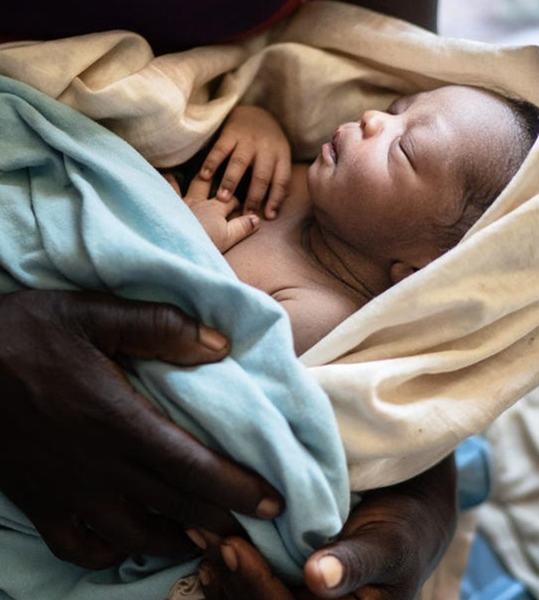
Workshop wrap up
Save the Children,

Slide 30
Next Steps…
Familiarise yourself with the MAMI Care Pathway Package: https://www.ennonline.net/mamicarepathway
Preparation of tools for your context
  Review and contextualise the MAMI Assessment Forms
  Review and contextualise the MAMI Enrolment and Follow-up Form
Recruitment, procurement and preparation for implementation
Establish MEAL System for MAMI Care Pathway
  Review, select and contextualise Tools from the MAMI MEAL Package (Register, Reporting Forms, Supervision Tool, Quality Benchmark, Database)
  Assign responsibilities for eporting and monitoring activities
Training on the MAMI Care Pathway for frontline health workers
Begin implementation pilot

Slide 31
MAMI Resources
MAMI Care Pathway Package: MAMI Care Pathway Package, Version 3 (2021) | ENN (ennonline.net)
Save the Children’s Resource Centre MAMI Page:
https://resourcecentre.savethechildren.net/spotlight/mami
MAMI Global Network Page, hosted on ENN https://www.ennonline.net/ourwork/research/mami
MAMI MEAL Package and Guidance:
Guidance Note on Save the Children’s Monitoring, Evaluation, Accountability & Learning Tools for MAMI implementation | Save the Children’s Resource Centre

Slide 32
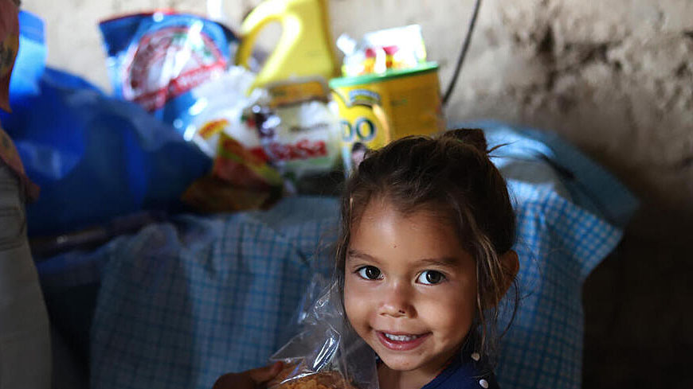
QUESTIONS?

Slide 33

Thank You
Content Hub: CH1575085

