Slide 1
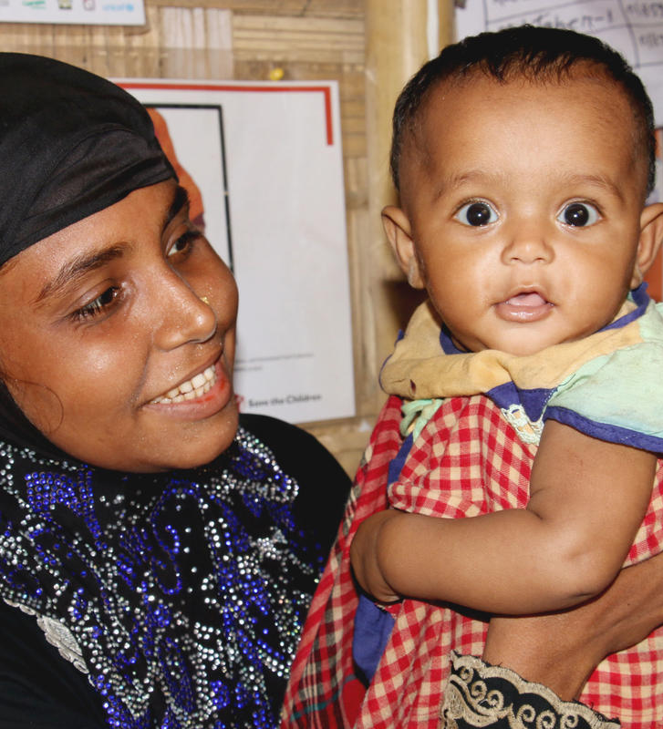
MAMI & THE MAMI CARE PATHWAY:
AN ORIENTATION
Crédit photo : Save the Children

Slide 2
INTRODUCTIONS
Notes:
Ask participants to introduce themselves: Name, Role, Organisation/Agency (if relevant)

Slide 3
Objectives
By the end of the orientation, you will be able to:
Explain the background of MAMI and how the MAMI care pathway is filling an existing gap in health services for infants less than 6 months
Define the MAMI care pathway package and its components
Content Hub: CH1304412

Slide 4
Time | Session
10 minutes | Introductions & Objectives
60 minutes | What is MAMI and why is it needed?
15 minutes | Break
60 minutes | The MAMI Care Pathway Package
15 minutes | Break
60 minutes | Applying the MAMI Care Pathway
15 minutes | Q & A
240 mins/ 4 hrs
Content Hub: CH1304412

Slide 5
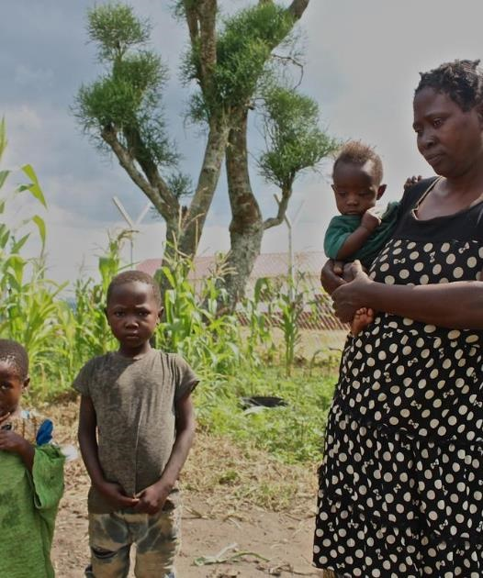
WHAT IS MAMI AND WHY IS IT NEEDED?

Slide 6
Management of small & nutritionally At-risk Infants under 6-months & their Mothers
Content Hub: CH1304412
Notes:
SAY:
MAMI stands for the management of small and nutritionally at-risk infants under 6-months and their mothers.
As the name suggests, the population focus of MAMI is small and nutritionally at risk infants under 6 months of age.
The focus for MAMI is not just the infant, but also includes the mother or caregiver of these infants who might require nutrition, health, mental health or social support themselves. The health of a baby is closely linked to the health of his/her mother so we must also consider their needs.
MAMI doesn't just focus on nutrition, but also health, nurturing care for early child hood development and maternal mental health and wellbeing.
This means that it works with the services that exist and connects them together so that the mother and baby get the support they need from birth to 6 months of age and there is shared responsibility amongst all sectors to support the youngest in our population to survive and thrive.
How this looks in practice will depend on the particular situation or context - one size does not fit all – meaning it can also be applied, and is intended to be applied, to both humanitarian and development contexts

Slide 7
Every small and nutritionally at-risk infant u6m and their mother is supported to survive and thrive
Notes:
Say: The MAMI Global Network’s vision, and Save the Children’s is that every small and nutritionally at-risk infant less than 6 months and their mother is supported to survive and thrive

Slide 8
Activity Defining small and nutritionally at-risk
WHAT DOES ‘SMALL AND NUTRITIONALLY AT-RISK INFANT <6MONTHS’ MEAN TO YOU?
Content Hub: CH1304412
Notes:
Work in pairs: 5 minutes. Feedback and discussion: 5 minutes.
Instructions for Group Activity (5 minutes)
In pairs/ individual brainstorm think about:
What does ‘a small and nutritionally at-risk infant <6months’ mean to you?
Think about what they would look like? How would you identify them as being small and nutritionally at risk?
What does being nutritionally at risk mean? At risk of what? Are some infants more at risk than others?
You have 5 minutes to discuss with the person next to you.
Instructions for plenary (5 minutes)
Ask pairs to share their discussions
Examples if needed: low birthweight babies, infants who are underweight, stunted and/or wasted.
Ask: “Do you see these types of infants often?” “Do you think there are many?” “Do you see any mothers with problems that affect her ability to care for her baby?”

Slide 9
Why is MAMI needed? High burden of nutritional risk amongst infants less than 6-months
Measurement | Global (z < -2) | Moderate (z -2 to -3) | Severe (z <-3)
Underweight (WAZ) | 20.1% | 11.9% | 8.1%
Wasted (WHZ) | 21.3% | 11.7% | 9.6%
Stunted (HAZ) | 17.6% | 9.2% | 8.4%
Low birth weight | 17.8% | 12.5% | 5.3%
Adapted from a slide produced by the MAMI GN
Notes:
SAY:
Infants can be born small and nutritionally at-risk, or they can become at-risk due to various sub-optimal circumstances in early life.
To give you an idea of the scope of the problem:
There is a significant burden of small and nutritionally at-risk infant globally.
The slides shows the results of an analysis done in late 2018 of DHS data from 54 countries over the last 10 years (75,804 infants).
Do --> Click
SAY:
Approximately 1 in 5 infants <6 months are born low birth weight
Approximately 1 in 5 infants <6 months are underweight, are stunted, are wasted
Do --> Click
SAY:
These infants are at increased risk of illness, death, poor growth and development, and long term non-communicable diseases too.

Slide 10
Why is MAMI needed? High risk of death in the youngest infants
Admissions to Therapeutic Feeding Center in Afghanistan
Notes:
SAY:
This slide shows the proportion of admissions to a therapeutic feeding center in Afghanistan who died
You can see that amongst admissions aged 0-5 months, deaths were the highest.
Infants under 6 months are the most vulnerable.

Slide 11
Activity Existing Protocols
Read your group case scenario and answer in groups:
With your existing services & protocols, what support would the mother & infant receive in this scenario?
What existing guidelines or resources would you use to guide their care?
GROUP 1: Scenario A
GROUP 2: Scenario B
GROUP 3: Scenario C
GROUP 4: Scenario D
Content Hub: CH1304412
Notes:
SAY:
Now we know who these infants are and the burden of small and nutritionally at-risk infants globally, let's take a look at the existing services and support that is available for them.
DO: Introduce the activity using notes below:
4 Groups (use breakout rooms if online), 15 mins group work, 10 mins feedback (2.5 mins per group).
Instructions for Activity:
Split participants in to 4 groups
Provide Handout: Group Work_Existing Protocols_Scenarios Handout
Assign each group one of the short scenarios:
GROUP 1: Scenario A
GROUP 2: Scenario B
GROUP 3: Scenario C
GROUP 4: Scenario D
Groups are to read their case scenario and answer the following questions (15 minutes)
What support would the mother & infant receive in this scenario?
What guidelines or resources would you use to guide their care?
Bring groups back together and give each group 2 minutes to share their discussion.

Slide 12
Why is MAMI needed? Gap in existing care
0 – 1m
Newborn care
2 – 6m
IYCF
Inpatient care
6 – 59m
Wasting treatment
GAP IN CARE:
Limited outpatient support
Limited monitoring
Adapted from a slide produced by the MAMI GN
Notes:
SAY:
As we saw in the last activity, there are existing services to support infants and mothers, such as newborn care, postnatal care, IYCF, treatment of acute malnutrition (CMAM), integrated management of childhood illness (IMCI) amongst others.
Some small and nutritionally at-risk infants and their mothers may be picked up in these existing services, but others are not.
Some may not present for help unless very sick or when they are older in age.
DO --> Click twice.
There are gaps in the continuum of care, services are dis-jointed, there is a lack of identification of risk in early life, and limited monitoring of those that are identified.
This means that currently, we are missing many of these infants within health systems globally. We are not identifying them routinely or supporting them as best we could.
There are existing services available for these infants and their mothers that we can build on by doing much more to identify them, connect different services together, and improve the quality of care.

Slide 13
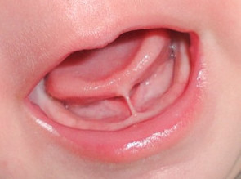
Missed Opportunities
Seeks health care for diarrhea episode
Tongue tie not picked up
Admission to CMAM
Mother stressed
Early intro of other foods
Breast feeding difficulties
6 MONTHS
Introduces infant formula
Infant growth faltering
Additional financial costs?
Preventable health care?
Adapted from a slide produced by the MAMI GN
Notes:
Guided plenary discussion:
Say:
“Let’s reflect on a real situation we could be faced with.
This infant is born with a tongue tie.
However, this isn’t picked up because no one looks inside the infant’s mouth during the routine health care.”
Ask: “What might be some of the impacts of an infant having an unidentified tongue tie?”
Do:
Wait for some answers.
Click
Say:
“Likely, breastfeeding difficulties will occur. The mother may become stressed due to this. The infant’s growth may falter. This could lead to the mother introducing infant formula as breastfeeding is challenging, and it could mean the mother decides to introduce other foods earlier than 6-months.”
“The child may experience diarrhea episodes due to use of infant formula, early intro of foods or compromised immune system.”
“The child may land up continuing to growth falter. At 6-months they may then be screened for malnutrition, found to be wasted, and admitted to a wasting treatment programme.”
Ask:
“In this scenario, what are the financial implications for the family?”
Do:
Wait for some answers.
Click
Ask:
“In this scenario, what use of health care could have been prevented?”
Do:
Wait for some answers.
Click

Slide 14
MODULE 2
THE MAMI CARE PATHWAY PACKAGE
Notes:
Talking Points:
To help put the MAMI vision into action and help fill the care gap for vulnerable infants under six months and their mothers, an international group called the MAMI Global Network has together developed the MAMI Care Pathway Package, which provides practitioners like yourselves with a resource to screen, assess, and support small and nutritionally at risk infants under 6 months and their mothers.

Slide 15
Overview of the MAMI Care Pathway Guiding Principles
Operationalizes WHO guidelines (2013)
Integrated care pathway
Uses existing services → what do you already have?
Bridges interventions
Development and emergency
Slide created by the MAMI Global Network
Notes:
Talking Points:
The MAMI Care Pathway, originally called the C-MAMI Tool, was created as a way to operationalise the WHO management of acute malnutrition guidelines released in 2013, which stated that infants with wasting but no complications could be managed in outpatient care. However, it did not provide information on HOW to do this. This is where the MAMI Tool started to develop. However nowadays, this has evolved way beyond that original vision to encapsulate not just infants who are technically defined as wasted, but all small and nutritionally at-risk infants.
The MAMI Care pathway is modelled on an integrated care pathway approach.
This means that it works with the services that exist and connects them together so that the mother and baby get the support the need from birth to 6 months of age. It makes more sense to work with what already exists and look how to do it better.
How this looks in practice will depend on the particular situation or context - one size does not fit all – therefore MAMI is applicable across all settings including both humanitarian and development settings.

Slide 16
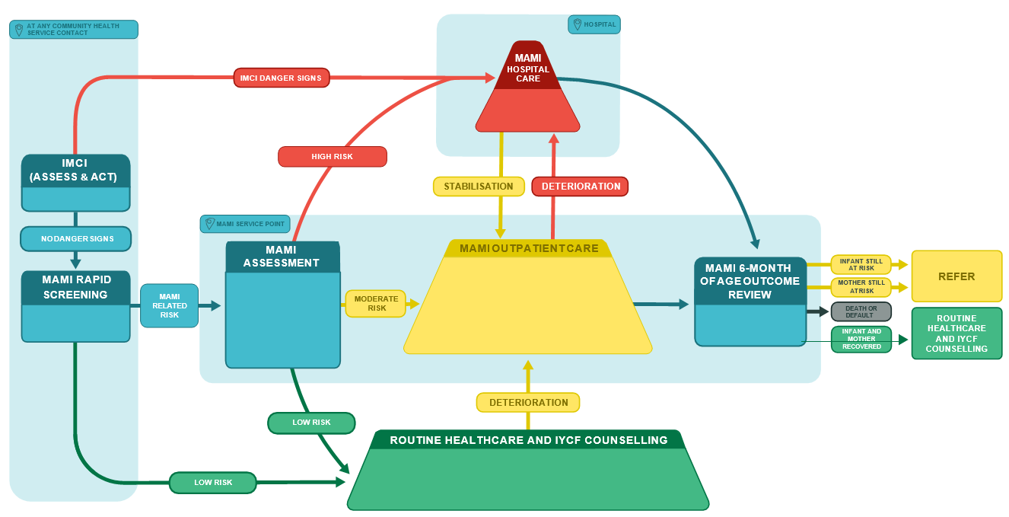
MAMI CARE PATHWAY ‘FLOW’
Slide created by the MAMI Global Network
Content Hub: CH1304412
Notes:
Notes for Facilitator Guide:
Use blank version to describe the pathway of care for different infants, using a baby image to walk along different paths (will share slides of this).
Say:
“So what does the MAMI Care Pathway involve in practice?”
“There are three key phases: screening, assessment, and management.”
“Screening is a quick assessment that takes place at any contact point with infants and mothers, like vaccinations or growth monitoring visits to cast a wide net for identifying at risk infants.”
[click next]
“If a high risk infant is identified, they will be referred for urgent hospital care.”
[click next]
“Most infants will have no problems and will be referred to routine healthcare and IYCF counselling.”
[click next]
“If a potential risk is identified at screening, then the infant and mother are referred for a more in-depth assessment by someone who has more specialised training. At this point, they would be classified into one of three situations:”
[click next]
“They might end up being low risk and be referred to routine healthcare and IYCF counselling.”
[click next]
“They may be high risk and need referral to hospital or inpatient care.”
[click next]
“Or they may be moderate risk but can be safely treated in an outpatient or community setting.”
“If infants in routine healthcare develop issues, they can be referred into MAMI programming.”
“The focus of MAMI care is those infants who are high risk or at moderate risk but medically stable. These are the infants who are followed up in MAMI care until 6 months of age.”
“At 6 months of age, infants and mothers have an outcome review and are either deemed recovered or referred on for continued support in other programmes.”

Slide 17
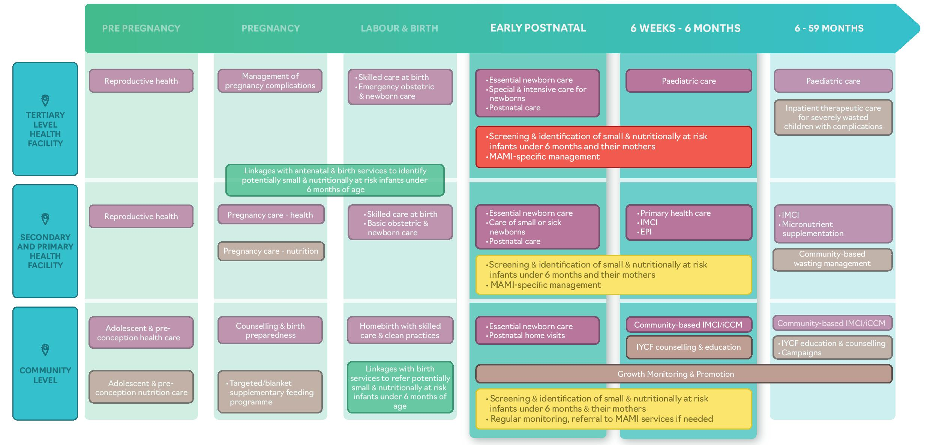
Overview of the MAMI Care Pathway Package Where does MAMI fit in the health system?
IDENTIFY
IDENTIFY
Slide created by the MAMI Global Network
Notes:
SAY:
As we have mentioned, MAMI builds on the existing services for infants less than 6-months and their mothers.
This slide shows how we can integrate MAMI in to various levels of a health system.
For example, maternity services e.g. labour units, postnatal and newborn care are important identification points for newborns at risk – at tertiary, secondary, primary and community level.
Another example is looking to continued services within the first 6 months of life such as immunisations, IMCI, primary health care and IYCF services – these are critical points for screening and identification, as well as important services that the MAMI Care Pathway must link to.

Slide 18
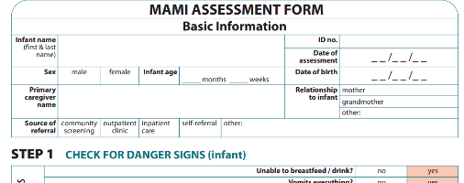
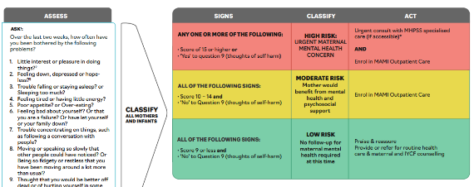
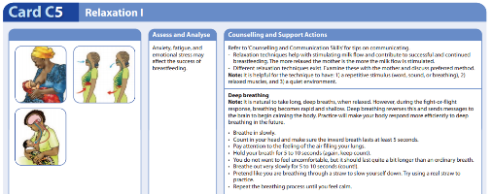
MAMI CARE PATHWAY PACKAGE
Health Worker Support Materials
User guides
Counselling Cards and Support Actions Booklet
Slide created by the MAMI Global Network
Content Hub: CH1304412
Notes:
Say:
The three core materials in the package are:
User Guides, which can serve as training materials or references and are formatted in the IMCI style;
Health Worker Support Materials, which include assessment forms for use by healthworkers; and,
Counselling Cards and Support Actions Booklet, which provides guidance on counselling for specific identified challenges for use by health workers.
In working groups later on in this session, you will get to look at the MAMI Care Pathway materials in more detail.
These materials may need to be adapted to the context to make them more relevant to how health workers work and what materials they already use.

Slide 19
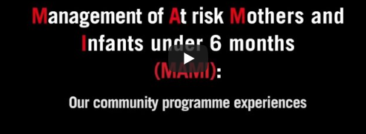
What is the MAMI Care Pathway? Overview
https://www.youtube.com/watch?v=Lyk60Yxm-xI
Content Hub: CH1304412
Notes:
Video only available in English.
5:50 minutes
Back up link: https://youtu.be/q3EUk2c1skc

Slide 20
Nutritional Risk in infants u6m Assessment of nutritional risk
INFANT’S NUTRITIONAL STATUS
INFANT’S
CLINICAL STATUS
MAMI RISK FACTORS
MOTHER’S
MENTAL HEALTH
FEEDING PRACTICES
Content Hub: CH1304412
Notes:
SAY: We determine nutritional risk status in infants less than 6 months by assessing 5 components
ASK: How does each component inform us about the infant’s nutritional risk? Let’s first consider the infant’s clinical status.. What does this tell us about the infant’s nutritional risk?
DO: Wait for answers, then ask about Feeding Practices, then Mother’s Mental Health, then Infant’s Nutritional Status.
Talking Points:
Infant’s Clinical Status:
If an infant has an underlying illness or clinical issue, this will impact their ability to properly grow and develop and they will be nutritionally at risk.
Feeding Practices:
If an infant is not being fed adequately, their growth and development will be negatively impacted and they will be nutritionally at risk.
Mother’s Mental Health:
Low moods and excessive worrying can lead to poor attachment and care practices, and challenges with breastfeeding
Poor maternal wellbeing can have negative impacts on child health and development
Therefore if a mother has a mental health illness, the infant is nutritionally at risk, as well as the mother needing support for her own wellbeing.
Infant’s Nutritional Status:
Poor nutritional status of the infant shows us whether there is already poor growth – we need to ‘treat’ these infants. Ideally we want to detect infants before they get to this stage, so we can ‘prevent’ poor growth. The MAMI Care Pathway aims to both treat and prevent malnutrition.
MAMI Risk Factors – see next slide.

Slide 21
Nutritional Risk in infants u6m MAMI risk factors
MAMI RISK FACTORS
Maternal orphan or mother absent
Low birthweight (<2.5kg)
Premature birth
Multiple birth
Adolescent mother (<19 years)
Mother with HIV
Maternal malnutrition (MUAC)
Excessive crying or sleep problems
Other concerns e.g. maternal TB, other illness, colic
Content Hub: CH1304412
Notes:
SAY: These are the MAMI Risk factors (read the list)
ASK: How do the MAMI Risk factors inform us about the infant’s nutritional risk?
Answer:
These are evidence-based risk factors that have been found to impact on an infant’s growth outcomes, therefore if the infant-mother pair have any of these risk factors they have an increased risk of being small and nutritionally at-risk.

Slide 22
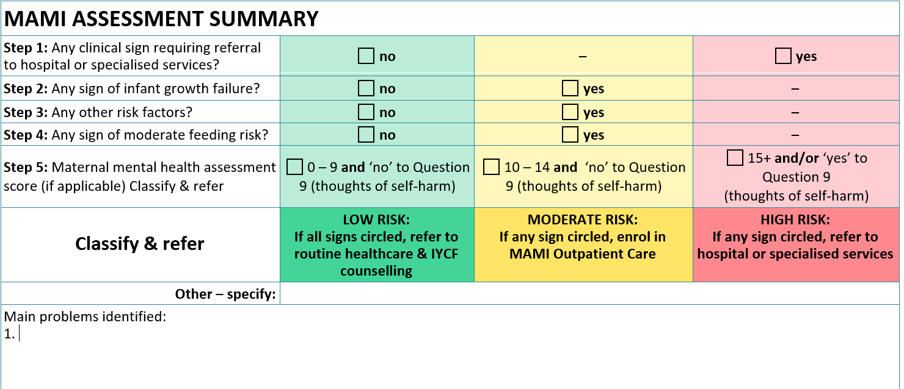
Nutritional Risk in infants u6m Classifying Nutritional Risk: Assessment Summary
Case Studies - C
Content Hub: CH1304412
Notes:
SAY: These 5 components are then used to classify the overall nutritional risk of the infant and mother using a traffic light scheme. Green meaning low risk, yellow mean moderate risk and red meaning high risk. The highest risk marked in any of the categories is taken as the overall risk.
DO --> Click

Slide 23
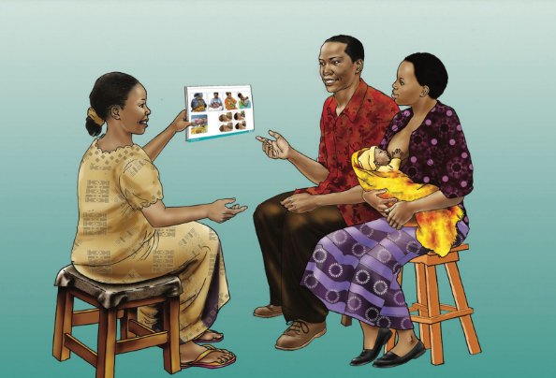
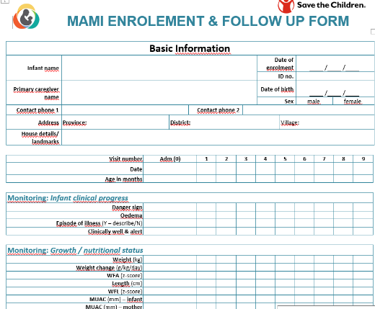
Support Package Components of MAMI care
Counselling on core topics for all enrolled pairs.
Tailored counselling and actions to address specific risk factors and problems as required.
Referral of mother-infant pairs to other relevant services as required.
Continuous monitoring of the mother-infant pair’s progress and wellbeing at each visit with visit frequency reduced or increased as considered appropriate by the health worker and mother.
Slide created by the MAMI Global Network
Content Hub: CH1304412
Notes:
SAY: There are 4 aspects to the support package:
Counselling on core topics for all enrolled pairs.
Tailored counselling and actions to address specific risk factors and problems as required.
Referral of mother-infant pairs to other relevant services as required.
Continuous monitoring of the mother-infant pair’s progress and wellbeing at each visit with visit frequency reduced or increased as considered appropriate by the health worker and mother.

Slide 24
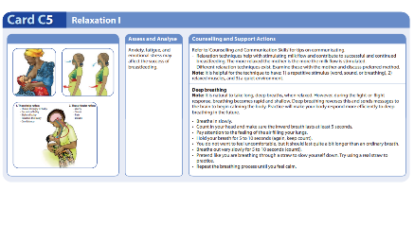
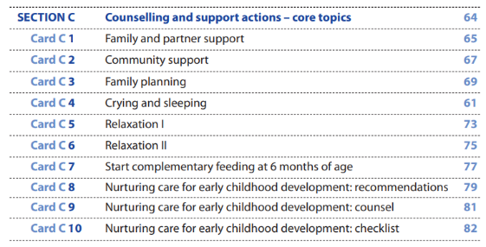
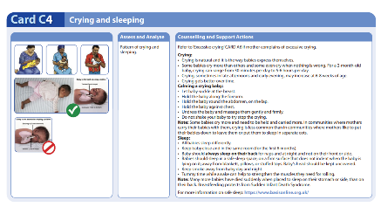
Support Package 1. Counselling on core topics for all enrolled pairs.
Content Hub: CH1304412
Notes:
SAY:
Component 1 of the support package: counselling on core topics for all enrolled pairs
The core topics include:
Family and partner support
Community support
Family planning
Crying and sleeping
Relaxation
Introduction of complementary feeding
Nurturing Care
These are topics that will be supportive and helpful to all caregivers of infants and they are therefore termed ‘Core Topics’
Each Core Topic has MAMI Counselling cards to aid health workers in providing support for this area

Slide 25
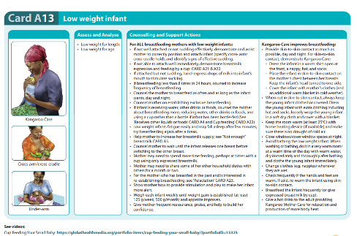
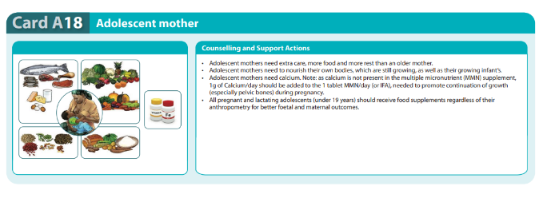
Support Package 2. Tailored counselling and actions to address specific risk factors and problems as required.
Content Hub: CH1304412
Notes:
SAY:
Component 2 of the support package: Tailored counselling can actions to address specific risk factors and problems This is the 1-1 counselling you are likely more familiar with.
This is where health workers provide specific counselling for the challenges problems and risk factors that were identified during the MAMI assessment.
For example, if incorrect position and/or attachment during a breastfeed is noted in the MAMI Assessment, you would provide targeted 1-1 counselling to support the mother to overcome this challenge and correct the position and attachment for an improved breastfeeding practice

Slide 26
Support Package 3. Referral of mother-infant pairs to other relevant services as required
How can we make the most of other services?
Content Hub: CH1304412
Notes:
SAY:
Component 3 of the support package: Referral of mother-infant pairs to other relevant services as required
There may be mother-infant pairs who have challenges we identify that we are not able to address in our services
In this case, we need to do our best to refer them to appropriate services to address that need or challenge
ASK: What challenges may mothers or infants have that you would need to refer? And where would you refer them to?
DO: Facilitate a discussion on referral of problems that can’t be addressed by MAMI directly e.g. severe mental health illness, maternal malnutrition to IMAM, illness to the Dr, food insecurity of financial problems impacting infant’s outcomes – may link to FSL/ Cash/ social protection projects.

Slide 27
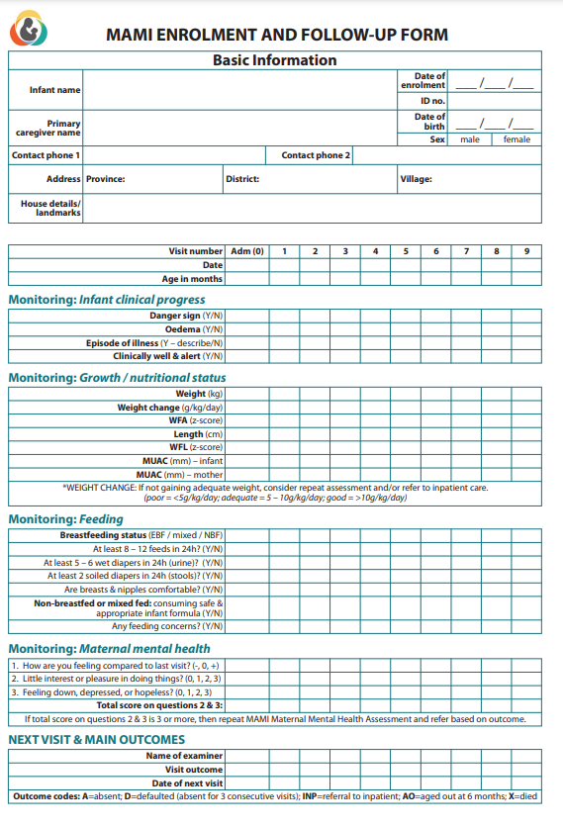
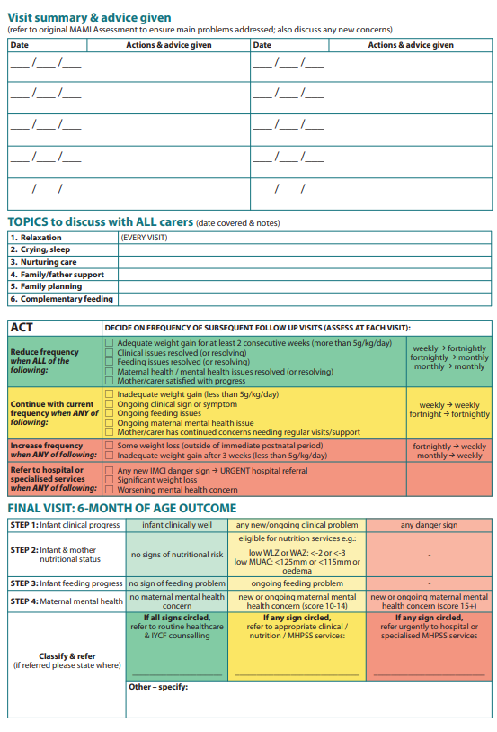
Support Package 4. Continuous monitoring of the mother-infant pair’s progress and wellbeing at each visit
Content Hub: CH1304412
Notes:
DO: Handout the Enrolment and Follow up Form
SAY:
Component 4 of the support package: Continuous monitoring of the mother-infant pair’s progress and wellbeing at each visit.
For [name of context], at first we will see enrolled mother-infant pairs every [add frequency of visits decided for the context]
At each visit, we want to monitor the infant and mothers progress and assess for any new risk factors
We use the Enrolment and Follow up Form to guide us in this process.
At each visit, we monitor how the infant and mother are progressing At each visit, we do a check for any danger signs, new illnesses, ongoing or now feeding or maternal mental health challenges.
At each visit we monitor the growth of the infant, as ultimately we want the infant to be gaining weight as we would expect – for infants under 6 months this is at least 500g or 0.5kg a month.
We calculate the weight gain as g/kg/day. The threshold we work with for infants <6 months if 5g/kg/day. If the infant is gaining less than this, they are not gaining adequately.
At each visit, we provide targeted counselling to the mother or caregiver on the challenges that we have identified in the initial assessment, and/or on any new challenges that have been identified during the follow-up visits.
It is important to keep monitoring enrolments for any new concerns but also track progress of the mother and the infant each visit.
How often we continue to see the mother and infant depends on how they are progressing.

Slide 28
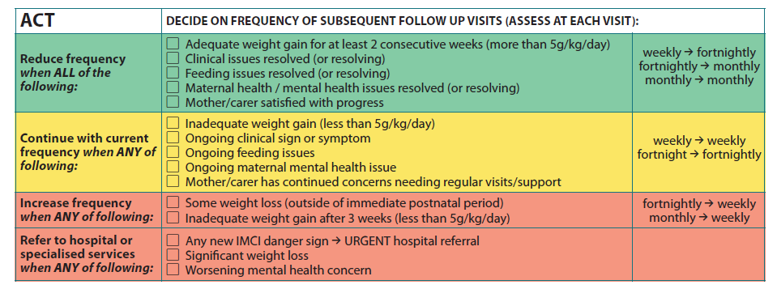
Support Package Monitoring: de-escalation of care
Content Hub: CH1304412
Notes:
SAY:
If they are doing well, then you can see them less often
If they begin to deteriorate again or a new ‘risk’ arises, you can increase the frequency again
If at any point they develop complications, they would be referred to the SC
This should be flexible and adjusted to the progress of the mother and infant
The idea is not to increase burden on the health worker or the mother
SAY:
We determine whether they are doing well or not by the criteria listed in this table
We look at the weight gain, in g/kg/day, and whether there are any clinical, feeding or maternal mental health issues
ASK: Why might it be important for mothers and infants to not be discharged from the MAMI Care Pathway?
DO: Wait for responses, then fill gaps with the following:
•New problems may arise or be identified during follow-up and may also require tailored support or referral.
•Important to keep monitoring the progress of the pair.
•Visit frequency is reduced or increased as considered appropriate by the health worker and mother.

Slide 29
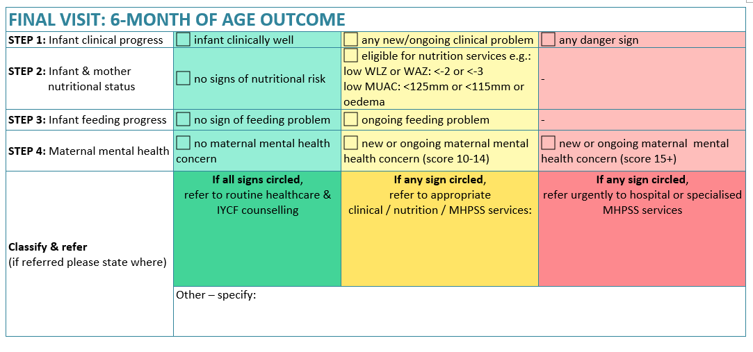
Support Package 6-month of age outcome review
Content Hub: CH1304412
Notes:
SAY:
At 6 months of age, each infant and mother should have a ‘6-month of age outcome’ final visit.
This is to decide if there is any continuation of support needed at 6 months of age.
Is the mother at risk? Is the infant at risk?
ASK: If the infant is wasted at the 6-month of age visit, what would you do?
Answer: refer to IMAM programme for assessment and admission.
ASK: If the infant has a feeding problem at 6-months of age, what would you do?
Answer: refer to IYCF support, 1-1 counselling ideally given a problem has been identified.
ASK: If the mother is experiencing a mental health challenge at the 6-month of age review, what would you do?
Answer: ensure the mother is linked with mental health support services
ASK: If the infant and mother are nutritionally well, show no feeding or clinical issues, or mental health concern, what would you do?
Answer: If there is no risk, the mother and infant can continue with routine healthcare such as ensuring they attend vaccination appointments and be encouraged to seek IYCF support if any feeding problems occur and seek healthcare if mother or child becomes sick.
SAY: As well as ensuring continuum of care, the 6-month of age review is also important as it allows us to assess the impact of the MAMI programme by seeing the outcome of the infant and mother at the point of exit from the programme.
SAY: there will be some infants and mothers that exit the programme before 6 months of age, for example those that default, transfers to other programmes or if an infant dies. In these situations it may not be possible to get the exit data but they can be coded as Default, Transfer or Died.

Slide 30
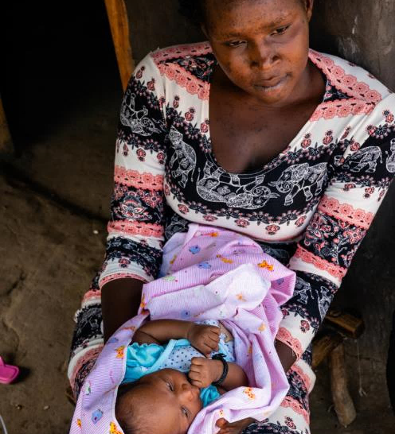
APPLYING THE MAMI CARE PATHWAY
Save the Children,

Slide 31
Remember this mother and infant?
Seeks health care for diarrhea episode
Admission to CMAM
Tongue tie not picked up
Infant growth faltering
Introduces infant formula
Breast feeding difficulties
Early intro of other foods
Mother stressed
6 MONTHS
Notes:
Show slide
Say
“Remember this mother and infant that we looked at yesterday?”
“Lets take this infant and mother through the care pathway process and see if their story would have been any different.”

Slide 32
Applying the MAMI Care Pathway
Less time spent on health care later on
Infant thriving
No diarrhea – no money spent on health care
Successful breastfeeding - no money spent on formula
Healthy child, Happy mother
Infant & mother monitored & supported
6 WEEKS
6 MONTHS
Tongue tie identified
Infant exclusively breastfed
Infant growing well
Notes:
Say:
Imagine they were screened at their first vaccination and the mother said she was having trouble with attaching the baby to the breast.
They referred the mother and baby to the health centre where they did a more thorough assessment using the MAMI assessment form and found the baby had a tongue tie.
They were directed for treatment and enrolled to the MAMI outpatient care for support with feeding and close monitoring.
Instructions for plenary discussion:
Ask: “What would be the benefits for the mother and infant?”
Examples: The child would be less likely to growth falter, and the mother less likely to introduce other liquids or foods than breastmilk. The mother would also be less likely to experience stress & worry about her infant.
Ask: “What would be the benefits for health workers, like yourselves?”
Examples: less visits to the clinic with diarrhoea, adding to workload. Less workload for CMAM programme. Less dissatisfaction with care. Greater job satisfaction.

Slide 33
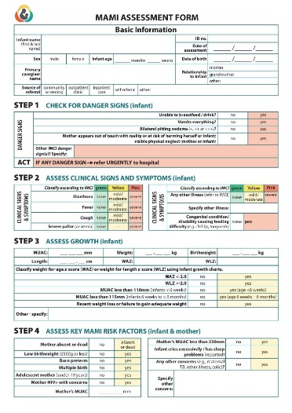
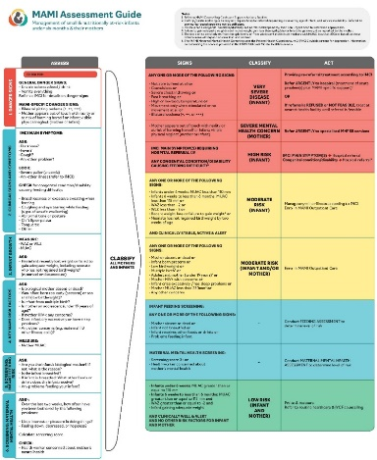
Activity Scenarios: Applying the MAMI Care Pathway
There are FIVE scenario: A, B, C, D and E
Go through your assigned scenario and take the following steps:
Look at the information provided in the completed forms (ASSESS).
Identify TWO PRIORITY PROBLEMS during the assessment (ANALYSE)
Decide which of the MAMI Counselling Cards would be useful to provide support to this caregiver and infant based on the problems identified (ACT)
Content Hub: CH1304412
Notes:
Say:
We are going to use some scenarios to really get familiar with the components of the MAMI Care Pathway
Instructions for Activity (60 minutes + 60 minutes for role play & discussion)
Split the participants in to 5 groups and assign each a Scenario from A, B, C, D and E.
Handout all the relevant documents for the assigned scenario, 1 full set of completed forms per person in the group.
Provide one per group of Module 8_Activity Sheet_Using the Counselling Cards
Participants are to go through the scenarios and take the following steps for the group scenario:
Look at the information provided in the completed forms (ASSESS).
Look at the results of the assessment and summarise the assessment, and classify the risk as low, moderate or severe (ANALYSE)
Identify TWO PRIORITY PROBLEMS during the assessment (ANALYSE)
Review the information and decide on the actions needed for those TWO PRIORITY PROBLEMS at the support visit with the caregiver and infant.
Decide which of the MAMI Counselling Cards would be useful to provide support to this caregiver and infant
After 45 minutes, bring everyone back together
Ask if there are any questions?
Note. This activity does not have feedback on the exercise in plenary as the purpose is for participants to become familiar with the materials.

Slide 34
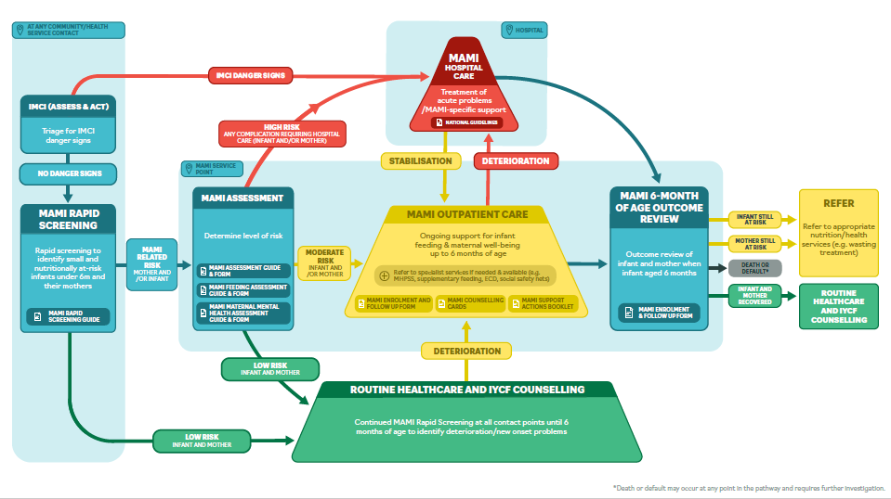
Summary
Screening & Assessment
Management & Monitoring
Review and Referral
Slide created by the MAMI Global Network
Content Hub: CH1304412
Notes:
Instructions for facilitator:
Summarise the 3 stages of the MAMI Care Pathway: Screening & Assessment, Management & Monitoring, Review & Referral
Show how there are different materials in the package to support the different activities on assessment and management (circled).
Note that this brings us to the end of the orientation and ask if participants have any questions?

Slide 35
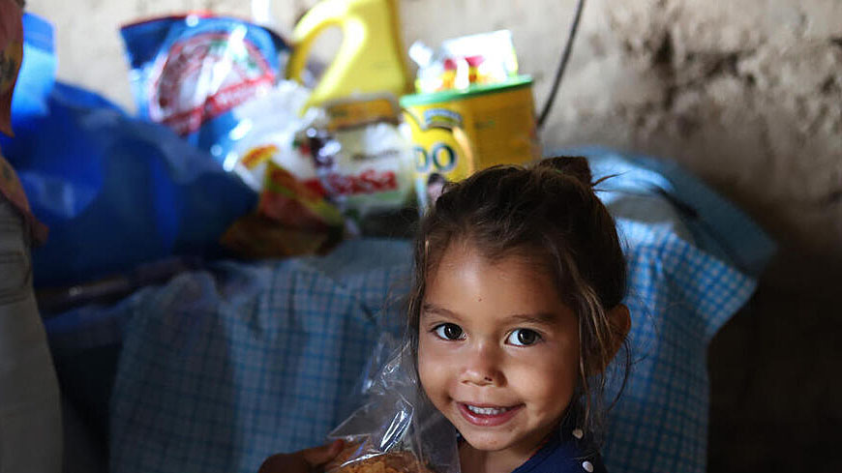
QUESTIONS?

Slide 36
Thank You
Content Hub: CH1575085

