Slide 1
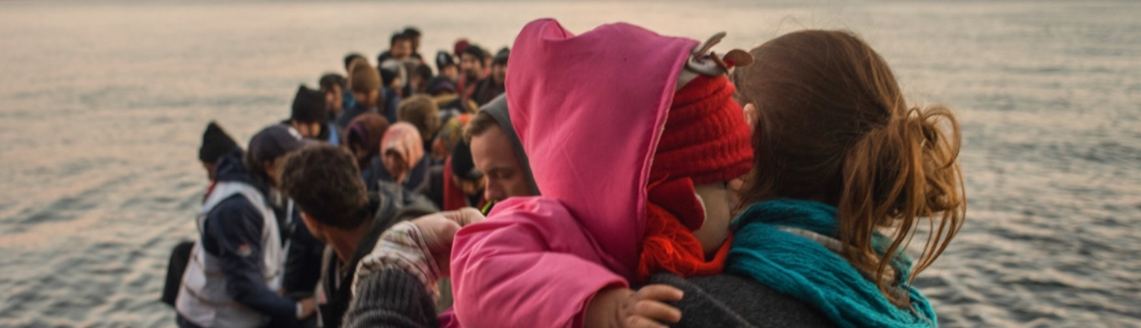
Infant and Young Child Feeding in Refugee Situations: A Multi-Sectoral Framework for Action

Slide 2
The framework provides guidance to managers and technical staff across sectors on what needs to be considered to create an IYCF friendly environment and facilitate optimal IYCF and child survival.
Notes:
What is it?
The Framework is designed as a tool to assist with integrating and mainstreaming international policies, standards and guidance on infant and young child feeding (IYCF) with all other sectors operating in the context.

Slide 3
IYCF Framework Orientation Video
Notes:
Video Link: https://youtu.be/biQC7HXMkWA
Video Length: 3.5 minutes

Slide 4
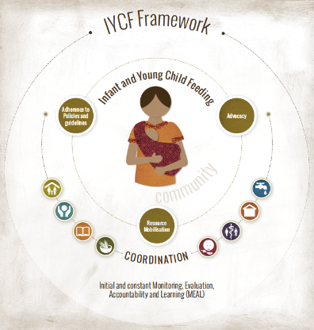
IYCF Framework: A Multi-sectoral Framework for Action
Action 1: Advocate for relevant stakeholders to consider IYCF
Action 2: Mobilize resources for IYCF
Action 3: Endorse key policies and adhere to operational standards
Action 4: Select appropriate IYCF activities
Action 5: Integrate IYCF with other sectors
Action 6: Coordinate IYCF-sensitive activities
Action 7: Implement monitoring, evaluation, accountability and learning
Notes:
SAY:
The ‘IYCF Framework: A Multi-Sectoral Framework for Action’ is a tool for UNHCR and partners, which has been designed for national and international staff working in refugee operations to provide guidance to managers and technical staff across all sectors on what needs to be considered to create an ‘infant and young child friendly’ environment and facilitate optimal IYCF. It can be used for emergency situations with or without refugees and can be adapted to situations other than emergencies. Key activities and over-arching opportunities for integration provide various ways in which each sector: camp management, FSL, WASH, Education, Child Protection, other nutrition programmes, Public health, settlement and shelter; can integrate IYCF into their programming.
The mother and baby in the Framework are the principle focus. They are supported by the community they live in which closely affects IYCF practices. The circle around them represents high level actions to consider such as advocacy, resource mobilization, and adherence to policies and guidelines. A coordinated effort between all sectors and IYCF ensures protection of rights of children up to 2 years and PLW. Monitoring, evaluation, accountability and learning (MEAL) ensure quality. The Framework has chapters on each sector, which includes examples of key integrated activities. The two-pagers for each sector will help succinctly elaborate that.
Common strategic objectives
Key integrated activities
Overarching opportunities for collaboration
Resources

Slide 5
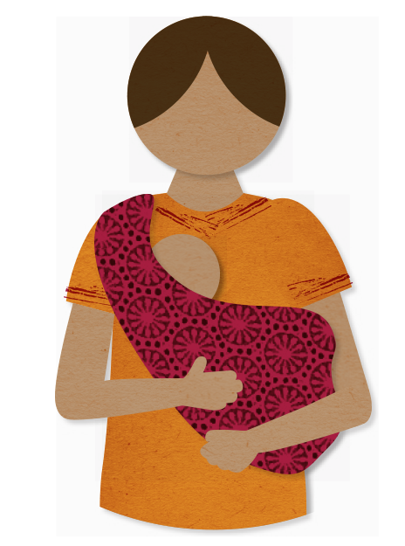
IYCF Framework:
How and where is it applied?
Piloted in 2015:
Kenya (Dadaab), Bangladesh (Cox Bazaar) and Jordan (Za’atari)
East Africa Regional Roll Out in 2017/8:
Kenya (Kakuma), Ethiopia (Gambella), and Uganda (Yumbe, Arua)
First phase emergency roll out 2017:
Bangladesh (Cox’s Bazar)
East Africa Roll Out in 2019
Rwanda (Mahatma), Uganda (Palabek)
COVID Response 2020
COVID Adaptations Briefer
West and Central Africa Roll Out in 2021
Chad and Niger
Notes:
For more information on the first pilots:
Rashid, B. ; Connell, N. ; Wilkinson, C. “IYCF-Friendly framework pilot in Jordan, Bangladesh and Kenya.” Field Exchange - Emergency Nutrition Network ENN 2016 No.51 pp.118-121 ref.10
http://files.ennonline.net/attachments/2463/FEX-51-WebFINAL_SHARE.pdf

Slide 6
VIDEO – The IYCF Framework in Action
Notes:
Video Link: https://youtu.be/FZKCrTN3DF4
Video Duration: 7.5 minutes

Slide 7
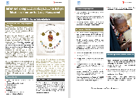
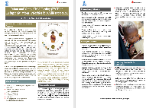
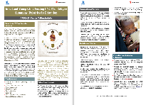
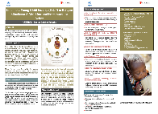
IYCF Framework Resources
Resources Available:
Resource Location:
IYCF Framework
Two-Pagers per Sector
COVID Adaptations Briefer
Orientation Video
IYCF in Action Videos
https://iycfehub.org/infant-and-young-child-feeding-framework/
OR
UNHCR SharePoint site: Public Health>> Nutrition and Food Security>> IYCF page
Notes:
Link below for UNHCR internal site: Public Health>> Nutrition and Food Security>> IYCF page
https://unhcr365.sharepoint.com/sites/drs-publichealth/Shared%20Documents/Forms/AllItems.aspx?id=%2Fsites%2Fdrs%2Dpublichealth%2FShared%20Documents%2FNutrition%20and%20Food%20Security%2FGuidelines%2FIYCF%20%2D%20UNHCR%20%26%20Save%20the%20Children&p=true

Slide 8
VIDEO – Nyathak and her triplets
Notes:
Video link: https://youtu.be/Bj3Z_ksP8nU
Video Duration: 3 minutes

Slide 9
THANK YOU

