Slide 1
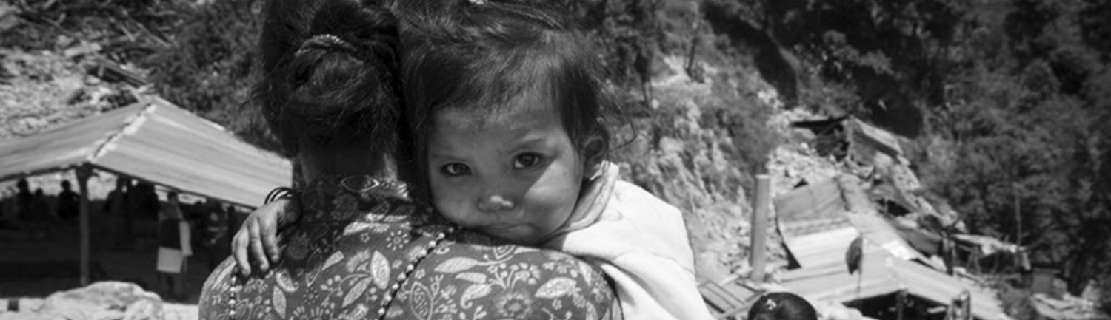
Considerations for Refugee Nutrition

Slide 2
SESSION OBJECTIVES
By the end of this session, you will be able to:
Describe the nutrition risks that refugees may face
List the key components of nutrition needs assessment within a refugee emergency
Recognize key IYCF actions within a refugee response and the role that you and other sectors can play

Slide 3
Refugees—How many people are affected?

Slide 4
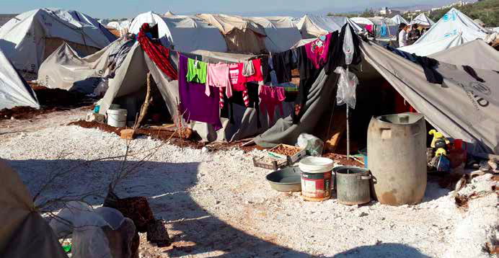
Why focus on nutrition for refugees?
How do you think a refugee’s nutrition might be affected by their situation?
Notes:
Refugees are people who have fled war, violence, conflict or persecution and have crossed an international border to find safety in another country. This has many effects on a refugee’s health, nutrition, and well-being. Ask the audience: What are some ways or considerations that you think might effect a refugee’s nutrition?

Slide 5
Key nutrition risks among refugee populations
Food insecurity
Increased prevalence of acute malnutrition, micronutrient deficiencies
Inadequate clean drinking water
Trauma—negative impacts on a mother or caregiver’s ability to feed and care for their children
Separation of mother and baby (impacts on breastfeeding, psychosocial/mental health)
Often indiscriminate distribution of breast milk substitutes, which interferes with breastfeeding. Breastfeeding is always the first feeding choice for infants, and it is important to protect breastfeeding to 2 years and beyond.
Often long journeys to get to the camp/final destination—lack of food, water
Often inadequate access to health and nutrition services
Safety
Notes:
In emergency refugee response operations, protection, food security and nutrition are closely linked. If refugees cannot obtain food in camps, they are likely to become food insecure and malnourished and may adopt unsafe coping mechanisms that endanger their security. If refugees in camps are not screened (where applicable), for acute malnutrition, or malnutrition programmes are not available, individuals with acute malnutrition will not be identified or treated, making it more likely that they will die or that their nutritional status will deteriorate. If infants and mothers who have difficulty breastfeeding are not assisted, those infants are at greater risk of serious malnutrition and death. If infants younger than 6 months, who are not breastfed are not identified and supported, such infants face a higher risk of serious malnutrition and death, as a result of eating inappropriate or contaminated food. If programmes do not promote and support good feeding and caring practices for infants and children younger than 24 months, infants and young children are at greater risk to be malnourished and to die

Slide 6
Overview—Aim of nutrition response in refugee emergencies
Aim: to improve the immediate food security and nutritional well-being of refugees, mainly by tackling the immediate and underlying causes of malnutrition.
A person’s nutritional status is impacted by:
Their environment,
water sanitation and hygiene (WASH),
access to health services,
food and nutrition security and care, and
shelter
Where these are inadequate, risk of malnutrition increases.

Slide 7
Nutrition objectives in refugee populations
Ensure access at all times to safe and nutritious food, sufficient to maintain a healthy and active life.
Respect the right to food and the right to health.
Ensure that refugees receive appropriate treatment for moderate acute malnutrition (MAM) and severe acute malnutrition (SAM).
Protect, promote, and support breastfeeding
Ensure access to adequate complementary feeding for children 6-23 months
For the non-breastfed infant <6 months, ensure access to safe BMS

Slide 8
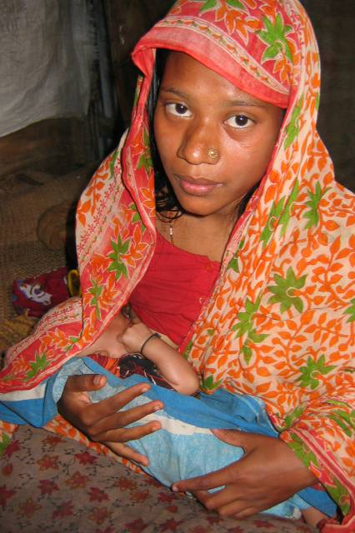
Target groups
Pregnant women
Adolescent girls
Infants and children <2 years of age
Other vulnerable groups
Notes:
Nutrition interventions aim to prevent malnutrition in the refugee population, especially among women, young children and other groups with specific needs; to identify, refer and treat malnutrition in individuals; and to monitor the nutrition situation in camps. The food security and nutrition sectors work closely with many sectors including the livelihoods sector to find longer term solutions, promote self-reliance, and improve nutrition opportunities.

Slide 9
Nutrition Needs Assessment
Understanding the nutrition situation and needs at the start of the refugee response is key
Initial rapid assessment for nutrition to understand:
Acute malnutrition prevalence (using MUAC and oedema screening)
Exclusive breastfeeding <6 months
Other key IYCF practices (early BF initiation, mixed feeding prevalence, BMS use, complementary feeding practices)
Cultural habits that may affect food intake or behaviors
Should be linked with and include expertise in public health, nutrition, WASH and shelter/site planning.
Within 3-6 months of the start of the emergency, a more comprehensive nutrition survey should be conducted
Notes:
In emergencies, food and nutrition security are often severely threatened and urgent action is required to ensure that all members of the community have access to adequate food. Those who are malnourished require nutritional rehabilitation. The extent of malnutrition has important implications for an emergency response. It influences decisions on the content and transfer mechanism of food assistance (in-kind or cash based interventions) and the requirements of selective feeding programmes. Ideally following the multi-sectoral needs assessment for refugee emergencies (NARE), a more detailed initial rapid assessment of the nutrition status of refugees should be conducted as soon as possible. The nutrition assessment is normally part of the health needs assessment. It should collect secondary data on and related to nutrition, assess acute malnutrition, and screening of key infant feeding practices. Assessments should be carried out by sectoral technical experts with appropriate qualifications and relevant experience. A more comprehensive nutrition survey should be undertaken as soon as feasible and no later than 3-6 months after an emergency starts. This assessment should evaluate the nutrition status of the population as a whole and should follow UNHCR's Standardised Expanded Nutrition Survey (SENS) guidelines.

Slide 10
Nutrition Needs Assessment
Rapid nutrition assessments should be continuous
All incoming children 6-59 months should be screened for acute malnutrition with ongoing mass screenings
All children <6 months should be screened for:
Visible signs of wasting, oedema
Breastfeeding vs BMS or mixed
Mother present?
Social criteria (e.g. trauma of mother, separation from mother)
Infants not breastfeeding and infants/children with acute malnutrition should be referred to health center/services

Slide 11
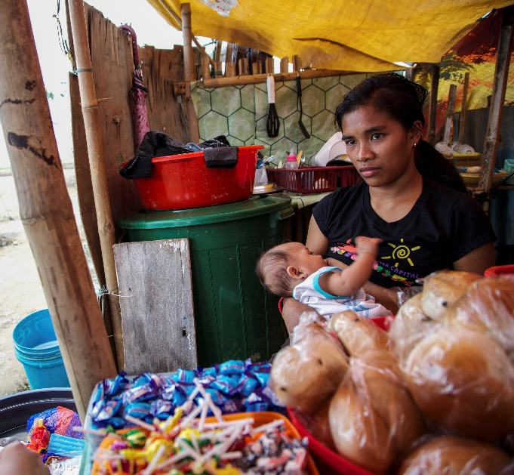
Infant feeding considerations in refugee emergency responses
Breastfeeding is the healthiest and safest way to feed an infant
Protecting, promoting, and supporting breastfeeding is always the preferred option
If the mother is not breastfeeding, support relactation as feasible
In instances where the mother is unable to breastfeed or is separated from the baby, wet nursing should be considered

Slide 12
Infant feeding considerations in refugee emergency responses
The use of BMS in refugee contexts is a last resort and should only be used if:
The infant is <6 months
The need for the individual infant has been determined through a skilled individual level assessment
The BMS used is an infant formula that is Codex compliant and meets the provisions of the Code. Generic formula is preferred, followed by commercial (branded) infant formula. Modified animal milks are a temporary ‘stop gap’ option.
BMS should not be provided to infants or children >6 months

Slide 13
Key IYCF actions
What can all sectors/responders do?
Prioritise access for pregnant and breastfeeding women and girls, children under 2, and their caregivers
Prevent the separation of children from their caregivers
Register households with pregnant women, children <2 years of age and higher risk groups
Provide privacy and safe space to breastfeed
Enable access to suitable complementary foods for children 6-23 months and additional nutritious foods for PLW
Disseminate standardised, clear and accurate messages on IYCF-E
Notes:
Ask: “What can we all do to create a ‘friendly’ environment for caregivers to practice recommended feeding practices?”
Once answers are exhausted from participants, reveal the text on the slide. Focus on those that were not mentioned.
Say: "This is a MINIMUM response for all emergencies. These are priority actions to undertake at the start of an emergency."

Slide 14
Non-technical supportive actions
Priority Access
Enable priority access for pregnant and breastfeeding women and girls, caregivers of children under 2 years and children under 2 years
Priority in queues
Targeted food programs
Allow stand-ins to attend on behalf of PLW
Establish referral pathways for services
Provide water when queueing
Consult with PLW when designing activities to enhance access
Safe, private, accessible
and comfortable waiting areas
Notes:
Ask: Why is ‘prioritising mothers/caregivers of children 0-24 months of age’ important?
Talking points:
During emergencies, there can be practical constraints for those with young children to accessing immediate essential needs and keeping their children safe at the same time.
A mother’s caring capacity can be constrained – they may be stressed, time constraints due to caring for family and home/dwelling and food provision, have limited mobility which constrains their awareness of and/or access to services, in some cultures they may have low visibility and decision-making power at household and family levels.
Women can also be at risk of gender-based violence accessing distributions, which can impact on their (physical and psychosocial) health.
All these constraints can impact women’s ability to care for their child/ren –including timely, adequate and appropriate feeding.
It is important to ensure easy, safe and secure access for caregivers to water and sanitation facilities, food and non-food items.
Ask: What actions/activities could be implemented?
Talking Points:
Registration and distributions often involve standing in queues for long periods of time. This can be physically exhausting and dangerous for pregnant women or women with young children, especially in very hot or cold weather, and if there is no shelter, food or water or if women do not have any carers to mind their children while they attend distributions. Queues can also be chaotic, with people pushing and fighting to get to the front. Infants and young children could be at risk of physical harm in such situations. (Play video to illustrate this.)
How we can support:
Separate queues/ priority for pregnant women or women with children <2 years to services (e.g. nutrition; health) and commodities (food and non-food)
Arrange shaded rest areas for mothers and children next to queues, with private spaces for breastfeeding
Provide water to mothers and children (>6months) while waiting in queues (e.g. distributions)
Assist mothers to keep their infants safe: e.g. provide material to be used as a baby sling
Advocate for other sectors to design programming that could be informed and adapted based on caregivers' schedules to facilitate greater access by these individuals
Allow PLW to nominate a stand-in to attend distributions etc
Prioritise targeted food supplementation and micronutrient supplements for pregnant and breastfeeding mothers
Others?
Emphasise: Advocacy to other sectors for their support is important to make it happen e.g. camp management (for planning of time, location and methodology for distributions), shelter (to provide shaded areas), WASH to provide water, etc.

Slide 15
Non-technical supportive actions
Prevent the separation of children from their caregivers
ID on child
Rooming in
Avoid unnecessary separation during outbreaks
Provide water / food /entertainment for young children to keep young children engaged / happy
Design distribution sites with mother/ baby pairs in mind
Prioritize mothers with young children in queue to avoid long wait times.
Provide baby slings
Notes:
Ask: Why is it important to prevent separation of a mother/ caregiver and her child?
Talking Points:
To support and enable breastfeeding
For respect and dignity of the caregiver and child
To support optimal caregiving
To ensure the child is not put at risk or, in the worst case, lost, by separation from their caregiver
Separating infants from their mothers for the first few days disturbed maternal attachment development (source. https://journals.sagepub.com/doi/full/10.1177/0890334420949514#)
Ask: "How can we prevent the separation of children from their caregivers"?
After some answers, click to show bubbles.
Talking Points:
Advocate for distribution sites and busy service points to consider mothers and young children in their design
Rooming in: recommend and support mothers and newborns to be kept in the same room after childbirth
Prioritise mothers with young children: if long wait times, young children may be more likely to wander off. Prioritise mothers with young children to reduce their waiting times for services and distributions.
In the same vain, provide water/ food/ entertainment to young children to keep them engaged and avoid wandering off.
Provide baby slings to keep babys close to mothers
ID on child e.g. making a cloth tag to tie around the wrist of small children during transit or when attending crowded locations - with their name, parents name, maybe chief's name.
Avoid unnecessary separation during outbreaks: ONLY interrupt breastfeeding or separate mothers and infants if there is good reason to believe that withholding breastfeeding and/or depriving infants of close contact with their mothers is justifiable. Read more here https://www.ennonline.net/attachments/4115/Infant-feeding-during-infectious-disease-outbreaks-a-guide-for-policy-makers.pdf

Slide 16
Non-technical supportive actions
Register households with PLW, children <2 years of age and higher risk groups
Children <2 years
Single headed households
Children <6 months
Pregnant women
BMS dependent infants
Orphans
Mothers & children with disabilities
Newborns
Image taken from dreamstime.com
Notes:
Ask: "Why might we want to register households with PLW, children under 2 and higher risk groups?"
Talking points:
Registration enables people to be visible and assists with programme planning by identifying the size and location of potential beneficiary groups.
In an emergency, those who are most vulnerable may have difficulty accessing services that are available. They may not know what they are entitled to or there can be practical difficulties for those with infants and young children.
Demographic age breakdown is important as IYCF-E practices and support services are highly age-dependent. Advocate for demographic breakdown during registration and assessments of children under two years with specific age categories: 0-5 months, 6-11 months, 12-23 months and 24-59 months.
Ask: "Who may we want to register, what groups of the population?"
After a few answers, click to reveal slide.
Talking Points:
Register vulnerable groups (e.g. orphans, pregnant women, single-headed households with children <2 years) to ensure targeted access to essential humanitarian support services (e.g. water, food, child protection; screening of caregiver-infant pairs for feeding problems).
Registration of newborns within 2 weeks of delivery is important because early feeding practices lay the foundation for later feeding practices and the benefits of breastfeeding

Slide 17
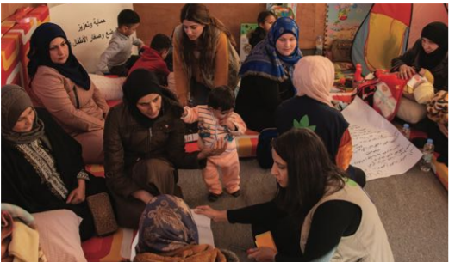
Non-technical supportive actions
Provide privacy and space to breastfeed
Baby Friendly Space in Arsal, Lebanon in 2020.
Joelie Asaf, Action Against Hunger
Arrival/ Registration Centers
Waiting Areas
Health Facilities
Distribution Points
Notes:
Ask: "Why would we want to provide privacy and space to breastfeed?"
Talking Points:
In many cultures, privacy is required for a woman to breastfeed, and in many other cultures it is preferred.
If there are busy, chaotic environments, this is not inducive for breastfeeding.
A quiet, relaxed space will support a mother to adequately breastfed her infant.
Ask: Where may we want to consider setting up a private space for mothers to breastfeed?

Slide 18
Non-technical supportive actions
Enable access to adequate and safe foods for children 6-23 months and PLW
Nutrition
FSL
Counselling
Education on adequate feeding / nutrition
CRI
Suitable foods
Vouchers/ Cash
Diverse foods
Fuel
Cooking equipment
Assistive products for children with disabilities e.g. adapted cups or utensils
WASH
Soap
Water
Food hygiene
Notes:
Facilitator guides participants with:
Complementary feeding is central to the nutritional status and health of children under 2 years during a critical period of development.
Ensuring adequate and safe complementary feeding and maternal nutrition is a multi-sector responsibility.
From 6-months, children need access to nutrient-dense culturally appropriate locally available complementary foods
Foods need to be suitable for children: digestable, nutritious, affordable.
But it's not just about access to suitable foods themselves, families also need to have access to cooking facilities, they need to be able to prepare food safely and hygienically, they need to be able to safely store food.
Ask: "With this in mind, which sectors do you think have a responsible role to play in enabling access to safe complementary foods?"
After responses click to reveal slide contents.
Talking Points:
FSL: a critical role to play in supporting improved and sustained access to suitable foods
Nutrition: education for caregivers on adequate feeding practices e.g. utilization, diversity, frequency, hygiene, continued breastfeeding. Technical support to caregivers experiencing feeding challenges through counselling.
WASH: ensuring adequate food hygiene is crucial in reducing the risk of contaminated foods and subsequent illness, to be able to practice this households need access to soap, sufficient water and information on food hygiene.
NFI: It’s not just about ensuring access to the food itself, but also the equipment and facilities to be able to cook food, and in a safe and hygienic way.

Slide 19
Non-technical supportive actions
Disseminate standardised, clear and accurate messages on IYCF-E
The right message,
at the right time,
from the right person,
to the right person
Notes:
Talking Points:
The right message:
Appropriate communication, clear messages, addressing the relevant, contextual problem on IYCF, identifying solutions.
Based on assessment of practices and needs
Relevant and reflect specific context; address current issues.
In language that the user understands. For example, the language you use for an adolescent mother should be different than the language you use for an older mother.
The right time:
Messages should also be delivered at the right time for the child e.g. age appropriate – deliver messages on complementary feeding when an infant is nearing 6 months of age, deliver messages on early initiation of breastfeeding in the last trimester of pregnancy
From the right person:
Messages should come from a trusted and trained person
Dissemination channels could include: registration and distribution points, community/religious meetings, ‘safe spaces’, at health/child-protection service sites, during household assessments, during distributions, etc.
To the right person:
Mothers, caregivers and the community are key targets for communication and key messages on IYCF-E that reinforce safe and appropriate IYCF-E.
Informing and engaging influential people in the community like grandparents, local leaders and religious leaders about safe and appropriate infant and young child feeding will help broaden the scope of support to mothers and caregivers.
Messages should be targeted to various audience: affected population, media, humanitarian agencies, and other key stakeholders.
Sectoral/cluster coordination should develop standard priority messaging, ensuring consistency.
Clear and consistent IYCF-E messages that reinforce safe and appropriate IYCF-E and address any specific concerns can have a large impact due to their potential reach
All messaging should be available (ideally) in multiple modes i.e. visual & oral/auditory to improve accessibility for caregivers/mothers with disabilities
All messages should be in the appropriate language, understood by illiterate populations, as relevant
For more on this, see: CDC (2018). Crisis and Emergency Risk Communication Manual. https://emergency.cdc.gov/cerc/manual/index.asp
"Communicate effectively about IYCF-E. The right message at the right time from the right person can save lives. To be effective it is important to be first, be right, be credible, express empathy, promote action and show respect. Among others, audiences include emergency-affected communities and their leaders, emergency responders and public health officials and the media."

Slide 20
IYCF Framework: A Multi-Sectoral Framework for Action by UNHCR and Save the Children
Notes:
"Let's now watch a video that highlights one initiative that seeks to encourage this IYCF Friendly environment by working across sectors to respond to the needs of caregivers and children 0-2 years."
Play video: https://www.youtube.com/watch?v=1QXaphU3R38
After the video, ask: "Let's imagine that Sara has a hearing impairment, what additional challenges to successful IYCF might she face? What types of adaptations make she require, across the various stakeholders mentioned in this video?"
Available at: http://www.unhcr.org/uk/nutrition-and-food-security.html

Slide 21
THANK YOU

