Slide 1
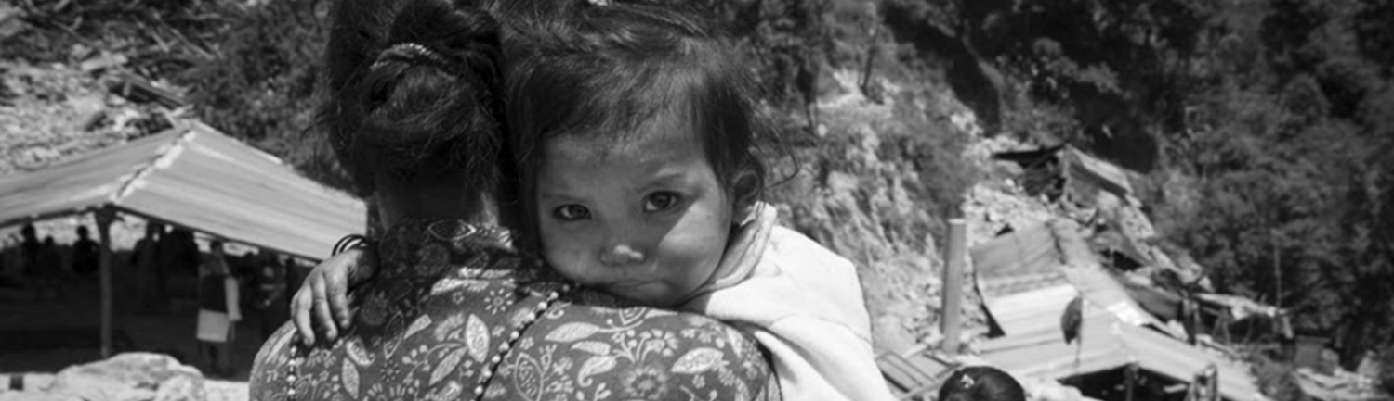
IYCF Multi-sectoral Training
Notes:
Start with asking why we promote IYCF at all? Why is it especially important in emergencies?

Slide 2
Training Plan
Time | Activity
 | Welcome
 | What is IYCF?
 | Why focus on IYCF?
 | Recommended IYCF practices
 | Tea Break
 | What can we do?
 | How can we do it?
 | Closing
Notes:
DO:
Go over the Training plan with the participants.

Slide 3
Session Objectives
By the end of this session, you will be able to:
Recognize the importance of IYCF.
Explain the recommended IYCF practices.​
Articulate that integration of IYCF in different sectors is crucial due to multisectoral causes of malnutrition.​
Identify how you can support IYCF and take action as an IYCF champion.

Slide 4
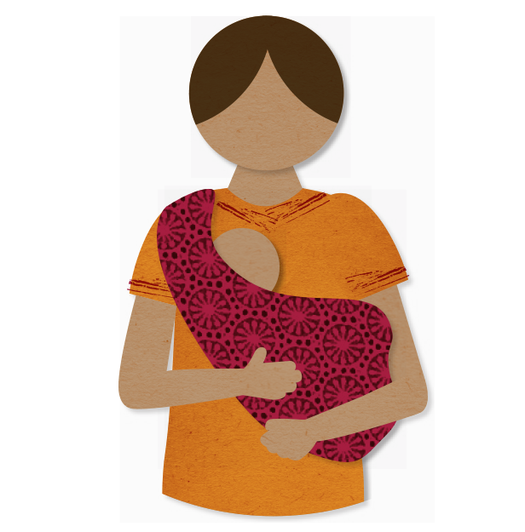
What is IYCF?
I = Infant
Y = Young
C = Child
F = Feeding
Infant = 0 - 11 completed months
Young child = 12 - 23 completed months
Notes:
SAY:
We know that today we have gathered to discuss about IYCF, and specifically “IYCF Framework: A multi-sectoral Framework for Action” and how YOU fit into this as a ‘champion’. So, let us first cover some basics. What is IYCF?
DO:
Now show the slide and go over the acronyms one by one.
SAY:
And now let us go over the age range of an infant and young child.
DO:
Now, show the age ranges and the picture.
SAY:
Therefore, the focus of IYCF is always children under two, and the mother and/or any other caregiver of that child because a child this age is dependent on their caregiver. Pregnant women are also a target group, because they will become a mother of a baby and that baby’s health hinges on his mother’s health, as we will demonstrate later in this session. So, you cannot ignore the caregiver/mother if your focus is a child under two years.

Slide 5
Why focus on IYCF?
Children <2 years of age are extremely vulnerable to:
Illness
Malnutrition
Death
Notes:
SAY:
Children, up to the age of 2, are most vulnerable to Illness, malnutrition and death. Children can fall sick more frequently and for longer periods of time and can these illnesses can have a life long affect on the child. Children can get malnourished, which means that their body lacks in nutrients or energy. You may have seen malnutrition yourself. See if you recognize any of the signs in the pictures.

Slide 6
Why focus on IYCF?
Period of rapid growth
Notes:
SAY:
Why are children under 2 most vulnerable to malnutrition? Because first year of life is a period of rapid growth. Body demands are the highest in the first two years of life.
Source: Rae Galloway, 2006. IYCF, New directions and program strategies

Slide 7
Why focus on IYCF?
Malnutrition happens early
Notes:
SAY:
And if those high demands, are not met, then the body does not grow as well as it should and leads to malnutrition.
SAY:
This graph represents a collective of body measurements of children under 5 years taken from 39 studies around the world.
DO:
Now, keep clicking to show the different important aspects one by one.
SAY:
We see that average weights start to decline at about 3 months of age and decline rapidly until about 12 months (mouse click), with a markedly slower decline until about 18-19 months and a catch-up pattern after that (mouse click). Growth faltering in weight for length/height is restricted to the first 15 months of life followed by rapid improvement. For length for age, growth faltering starts immediately after birth, lasting well into the third year.
Source: WHO, 2010

Slide 8
Why focus on IYCF?
There are long-term consequences
Adequate nutrition during the first 1,000 days:
Prevents illness and premature death
Associated with better performance in school later in childhood.
Inadequate and nutrition and growth during the first 1,000 days is associated with:
Obesity, diabetes, and other noncommunicable diseases later in life
Lower future economic productivity.
Notes:
SAY:
Optimizing growth in first 1,000 days—from conception to a child’s 2nd birthday—helps to prevent illness and premature death and is associated with better performance in school later in childhood.
Poor nutrition during the first 1,000 days makes a child more susceptible to developing obesity, diabetes, and other noncommunicable disease later in life. Inadequate nutrition and growth during a child’s is associated with lower future economic productivity.
For infants who already have inadequate growth, rapid catch-up weight gain in the first two years is important for preventing long-term under nutrition and achieving decreases in illness and death.
If a child does not get the opportunity to catch up before the age of two, rapid weight gain in later stages of childhood is not desirable as it significantly increases the risk of chronic diseases.
It has been shown that Body size at 2 years of age is clearly associated with future enhanced human capital. Improved complementary feeding interventions can go as far as having a significant effect on adult wages-up to 46% for male adults in one study.
Optimal feeding practices reduce healthcare costs because children get sick less often and for lesser duration. Lesser number of sick days mean lesser missed work days by the mothers and lesser workload for mothers.

Slide 9
Why focus on IYCF?
Poor nutrition causes 45% of deaths in children under 5. That’s 3.1 million children each year.
Notes:
Need updated graph
SAY:
The major causes of under 5 mortality such as pneumonia, diarrhea, measles, and even neonatal complications are common preventable or treatable diseases. Malnutrition increases children’s vulnerability to these conditions. Malnutrition is the underlying cause of 54% of these diseases.

Slide 10
Why focus on IYCF?
Infants aged under 6 months are at highest risk of dying
Programming guide for IYCF by UNICEF, 2011
Notes:
SAY:
Here we can see that the risk of death among young children is even more when compared to children under five years. In this graph the percentage of deaths in admissions of children under 6 months is 17% as compared to 5% in children aged between 48 to 59 months.

Slide 11
Why focus on IYCF?
Child morbidity/illness is preventable
Notes:
SAY:
The good news is that all this: illnesses, malnutrition and deaths can be prevented! Therefore, it is so important that IYCF is not overlooked. Prevention is better than cure.
DO:
Now show the graph.
SAY:
This graph shows relative risk of not breastfeeding for infections and mortality compared to exclusive breastfeeding from 0-5 months. The risk is lowest when fed only breastmilk, shown in green and the risk is highest when not breastfed at all, shown in red.

Slide 12
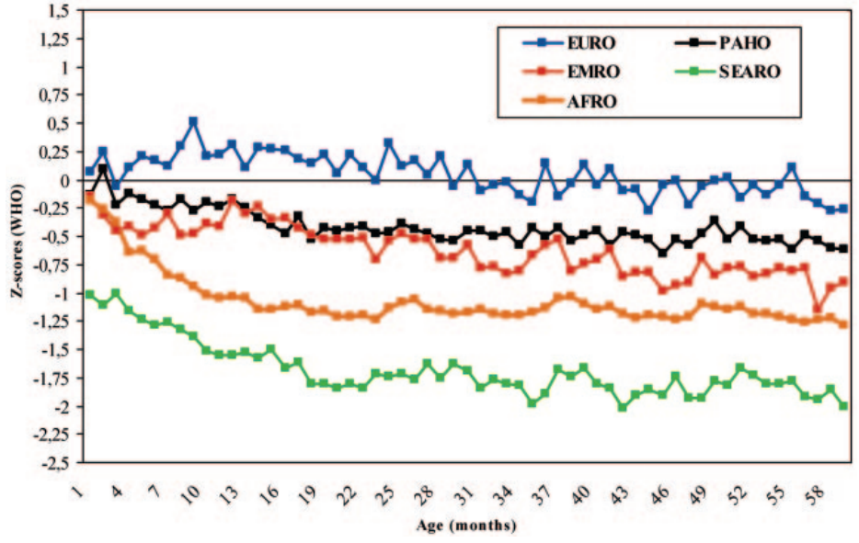
Why focus on IYCF?
Malnutrition is preventable
Weight for Age by Region
Notes:
SAY:
This graph shows that a child’s weight is predetermined even before his birth and is affected for the years to come. This is why the time from pregnancy to child’s 2 years of age is called the ‘window of opportunity’.
SAY:
We can see here that children from different regions start off with different birth weights, one of them has children who are starting off with lower birth weights meaning they are already malnourished at birth (mouse click). These children and other children experience sharp faltering in the first year of life confirming the importance of concentrating preventative interventions at this age or earlier. Improvements in intrauterine growth per se can be expected to reduce the prevalence of underweight.
Source: WHO, 2010

Slide 13
Why focus on IYCF?
Child Mortality/Death is Preventable
Notes:
SAY:
This graph shows that two of the most important appropriate IYCF practices actually two of the most important practices to prevent child deaths in comparison to other health practices. A higher percent of child deaths could be prevented with 99% coverage of appropriate breastfeeding and complementary feeding (CF). We will talk about CF shortly.

Slide 14
Recommended IYCF Practices
ONLY breastmilk
Other solids, semi-solids, liquids at 6 months with continued breastfeeding up to 2 years
Source: GNC IFE training 2011
Notes:
SAY:
This brings us to the question: what are the recommendations for optimal IYCF practices? We talked about breastfeeding and complementary feeding in the last slide. Lets take a closer look at them.
DO:
Now, show the slide.
SAY:
Optimal IYCF recommendations are:
Early initiation of breastfeeding – this means breastfeeding within 1 hour of birth
DO:
Mouse Click to show definition of EBF.
SAY:
Exclusive Breastfeeding for 6 months – exclusive breastfeeding means an infant receives only breastmilk, no other liquids or solids, not even water, with the exception of necessary vitamins, mineral supplements or medicines.
Continued breastfeeding to 2 years or beyond - Complementary feeding encompasses continued breastfeeding, the introduction of complementary foods at six months, and how that is done in the nutritional and developmental interests of the child.
DO:
Mouse Click to show definition of CF.

Slide 15
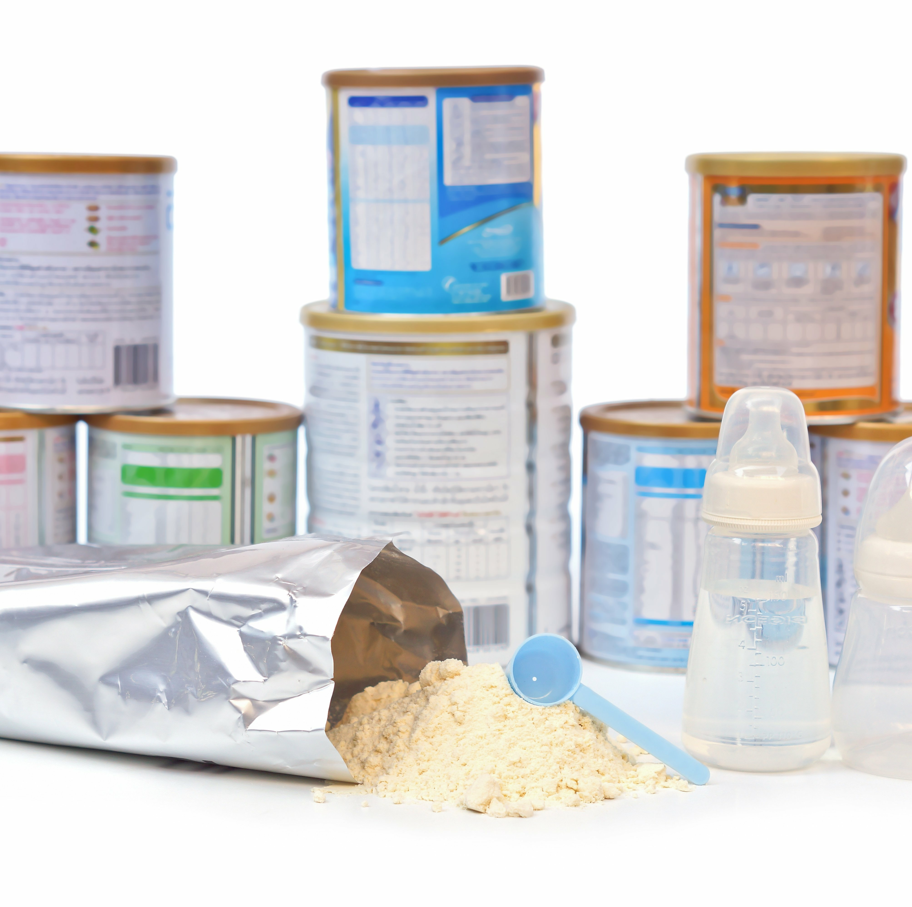
Recommended IYCF Practices
Notes:
SAY:
We saw earlier in a graph how important feeding only breastmilk is. Therefore, it is recommended to not to use any artificial feeding which includes feeding breastmilk substitute or infant formula, unless it is medically necessary. Also, no use of feeding bottles, treats or pacifiers.

Slide 16
Artificial feeding is always risky
Provides no active protection
Infant formula powder is not sterile
Increases food insecurity and dependency
Bottle and teats present an extra source of infection
Increases cost in time, resources and care
Notes:
Artificial feeding: feeding with breast milk substitute.
It does not have the protection of breastmilk – a breast-milk substitute is a different substance than breastmilk. i.e. not designed to meet the age/stage of infant/child, and it does not contain the same things. See visual slide to show the differences between breastmilk and artificial milk: http://illinoisaap.org/wp-content/uploads/Whats-In-Breastmilk.pdf
It is not sterile, it increases food insecurity and dependency, it is costly in time, resources and care, and bottle feeding increases risk further due to difficulties in cleaning, adding a source of infection.

Slide 17
Artificial feeding RISKIER in emergencies
Bacterial contamination
Lack of water
Overcrowded conditions with people on the move
Contaminated water
Limited, insecure supplies and resources
Notes:
The risks of artificial feeding are heightened in emergencies, with constraints on water and sanitation, fuel, preparation, storage and supplies.
Emergencies are characterized by extremely infectious environments.
Considerable skilled and well resourced support are needed to minimise the risks of artificial feeding in this environment.
Why? Because, infant formula does not have the protective properties of breastmilk or safe feeding mode - breastfeeding

Slide 18
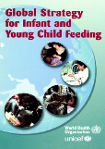
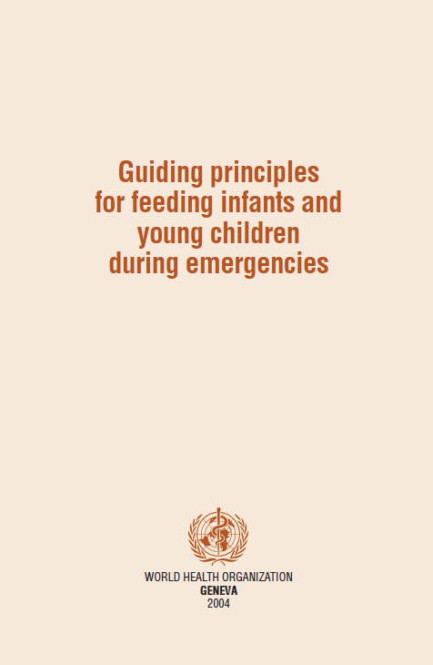
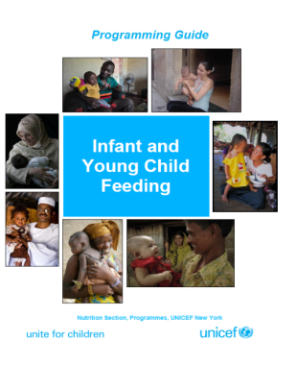
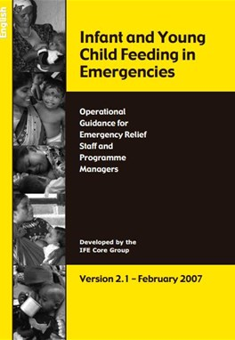
Recommended IYCF Practices
Notes:
SAY:
There is a number of legislature, guides and strategies available on IYCF.
DO:
Show one by one.
SAY:
The International Code on marketing of BMS highlights the importance of breastfeeding and prioritizes protection and promotion of breastfeeding in order to ensure proper BMS usage and distribution by enlisting the responsibilities that fall on health workers, health systems, manufacturers and distributers regarding BMS.
Global strategy for IYCF specifies responsibilities of governments, international organizations, non-governmental organizations and others in IYCF.
The guiding principles for actions that help prevent increased morbidity and mortality informing decision-makers about the key interventions required to protect and promote optimal feeding for infants and young children that should be routinely included in any emergency relief response.
Operational guidance on IYCF-E is a non technical guide on how to ensure appropriate infant and young child feeding in emergencies.
SPHERE handbook enlists policy guidance and coordination on IYCF-E, and provision of basic and skilled support for IYCF-E as minimum standards of IYCF-E.
UNICEF’s IYCF programming guide details the “how” of programming at all levels of technical IYCF aspects.

Slide 19
Activity: Myths and Misconceptions
TRUE
FALSE
Notes:
Participant instructions:
One side of the room is “true” and the other is “false”. (Online alternative: Zoom Poll)
When you see each statement on the screen, QUICKLY and SILENTLY move to the end of the room with which you agree i.e. either move to the “true” end or to the “false” end of the room.
We shall discuss each statement.
Move back to the centre of the room after each discussion.
WARNING! As we are discussing myths and misconceptions during this session, you will hear some statements that are not true.
Please go with your own knowledge, experience and beliefs rather than following your colleagues – this will greatly help us to learn from each other and this activity.
Facilitator notes:
Each statement projected is TRUE
This means that the statement itself may not be the common myth – instead, it is linked to a common myth (which should be drawn out by the facilitator as part of the discussion)
While this may make the exercise/myth less obvious, this method has been intentionally chosen to avoid reinforcing myths: the more often we hear something, the more likely we are to remember / believe it.
Repeating misinformation generally increases familiarity and truth ratings, but can also make correction more salient and effective when it is correctly refuted / debunked.
Therefore, a detailed discussion structure is provided below, which facilitators are strongly encouraged to follow for each statement.
Make every effort to create a safe space for learning and discussion by demonstrating compassion and understanding for why participants may believe certain myths.
Facilitator instructions:
Do NOT cover all the myths here – choose the most relevant ones for the context.
Instruct participants to stand in the middle of the room
Project the statement, and instruct participants to quickly move to the "true" or "false" end of the room to reflect their level of agreement with the statement (without discussing!)
Follow this general discussion outline (1. State the Truth 2. Warn that a myth is coming 3. Explain how the myth misleads 4. Finish by repeating the fact multiple times)
SAY: This statement is TRUE. Repeat the statement.
ASK participants standing on the FALSE side: Why did you move to this side? What have you seen / experienced? Do you think the mothers/caregivers/people you work with believe this statement is true? If not, what do they believe instead / what have you heard mothers/people say? (Draw out the myth)
SAY: This is a WARNING that what I am about to say is not true, but it is a common myth that... <state myth> . (Do not repeat the myth more than one time)
ASK participants standing on the TRUE side: Why did you move to this side? What do you know to be true? What have you seen / experienced?
EXPLAIN the origins of the myth / how the misunderstanding might arise.
Note: It is important not to dismiss mother's / people's lived experience, but to sensitively explain why a certain situation / experience may have been misinterpreted.
Note: For debunking to be effective, it is important to provide detailed refutations
REPEAT the true statement
Instruct participants to move back to the middle of the room.
Note: information to guide the discussion is provided for each statement.

Slide 20
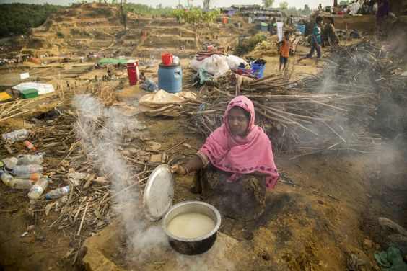
TRUE
FALSE
IF A MOTHER IS NOT EATING WELL, HER MILK WILL STILL BE GOOD ENOUGH FOR HER BABY
Notes:
It is true that a mother who is not eating well should continue to breastfeed her baby
(WARNING!) Myths:
If a mother is not eating well, her milk will not be good enough for her baby
Malnourished mothers cannot breastfeed / make enough milk / make good enough milk
If a mother is not eating well / malnourished, it is better to give formula
Why this myth exists:
Influence of the formula industry

Slide 21
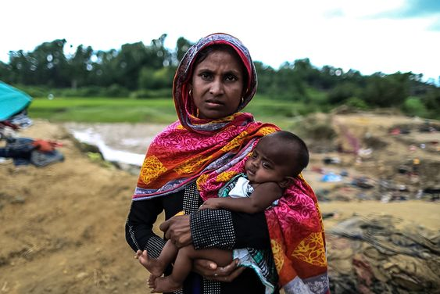
TRUE
FALSE
STRESSED MOTHERS CAN BREASTFEED
Notes:
It is true that stressed mothers can breastfeed
(WARNING!) Myths:
Stressed mothers cannot breastfeed
Stressed mothers cannot make enough breastmilk for their baby
Negative emotions such as stress are passed from mother to baby, harming baby
Breastfeeding during an emergency will just cause extra stress for a mother
Why this myth exists:
In times of stress, babies feed more frequently
Babies are often more fussy / unsettled during (and between) feeds
Misinterpretation: baby is not getting enough breastmilk

Slide 22
STRESSED MOTHERS CAN BREASTFEED
TRUE
Mothers who are very stressed can still make plenty of breastmilk
Stress may temporarily interfere with milk flow ("let down") but it does not affect milk production.
Breastfeeding reduces stress/ aids relaxation in mother and baby
How to help: reduce stress for the mother, support relaxation and connection, keep mother and baby close together (e.g. in a sling), encourage frequent breastfeeding and skin to skin
Notes:
The truth:
It is normal and expected for baby's behaviour to change during an abnormal situation – they are likely to be more fussy and upset than usual, feed more often than usual, wake at night more often and be less tolerant of maternal separation for reasons that have nothing to do with their mother's capacity to make enough breastmilk (e.g. change in structure and routine, feeling their parent's stress etc.) but are interpreted as such.
Being close to their mother and breastfeeding is comforting for baby, so they do it more often.
Research tells us stress has no impact on milk production. But it can slow the release of milk ("let down"). Maternal adrenaline inhibits the let-down reflex, slowing milk flow and making babies fussy or frustrated at the breast. This can mistakenly result in concerns around breastmilk supply
In fact, behaviours such as fussing and crying at the breast are milk stimulating behaviours – baby is working to help the milk to flow.
Staying close to baby, focusing on baby and thinking about love for baby while feeding will release hormones that make the milk flow and help mother and baby feel more relaxed. Emergency responders should facilitate and encourage this closeness and connection.
Further reading: Babies and toddlers might not know there's a fire but disasters still take their toll (theconversation.com)
Facilitator note: This will be addressed further in "Breastfeeding in Emergencies" and "MHPSS"

Slide 23
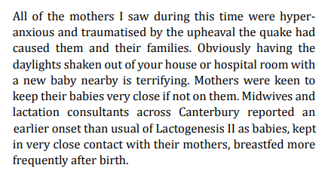
STRESSED MOTHERS CAN BREASTFEED
TRUE
Hargest-Slade AC, Gribble KD. Shaken but not broken: Supporting breastfeeding women after the 2011 Christchurch New Zealand earthquake. Breastfeed Rev. 2015 Nov;23(3):7-13. PMID: 27183769.
Notes:
Facilitator notes:
Lactogenesis II is defined as the onset of copious milk production , which typically occurs between 48 and 72 h postpartum.

Slide 24
TRUE
FALSE
BREASTMILK PROVIDES ALL THE FLUIDS THAT A 5 MONTH OLD BABY NEEDS, EVEN IN VERY HOT WEATHER.
Notes:
It is true that breastmilk provides all the fluids that a 5 month old infant needs, even in very hot weather.
(WARNING!) Myth: Babies need extra water/fluids when it is very hot
Why this myth exists:
When it is very hot, baby's behaviour may change
They tend to feed more often
They may fuss and cry more because they are uncomfortable in the heat
Misinterpretation: baby is thirsty / not satisfied / dehydrated

Slide 25
BREASTMILK PROVIDES ALL THE FLUIDS THAT INFANTS UNDER 6 MONTHS NEED, EVEN IN VERY HOT WEATHER.
TRUE
Breastmilk composition changes in response to the infant's needs.
WHO and UNICEF recommend that infants under six months are exclusively breastfed (nothing but breastmilk, not even water)
Risks of giving water:
Illness e.g. diarrhoea
Reduced nutritional intake / malnutrition
Disruption of breastfeeding
Newborns: very risky!
Notes:
The truth:
While it is easy to understand why baby's behaviour might be misinterpreted, what we in fact know is that:
Just as adults get thirstier in hot weather, so do babies
Breast milk is more than 80% water, especially the first milk that comes with each feed.
Feeding more often but for shorter durations helps babies get more of the watery foremilk which they need to satisfy their hydration needs – babies are very clever, and take what they need!
The composition of breastmilk will change in response to the need of baby-a higher water content in the hot weather and a higher fat content in the colder months.
Risks of giving water:
Infection / illness (water – or cups/bottles used to give water - may be contaminated)
Reduced nutritional intake (baby's tiny stomach fills up with water instead of nutritious breastmilk, so can result in weight loss / insufficent weight gain.
Reduced breastmilk production (baby's stomach is filled with water, so baby is less interested in breastfeeding, leading to gradual decline in milk production)
In newborns, giving extra water is especially risky (increased jaundice risk, excess weight loss, oral water intoxication due to having immature kidneys)
For older babies & toddlers, continue to breastfeed and offer water by cup in moderation. Breastmilk supplies plenty of fluids, so many older babies or toddlers who breastfeed without restriction can get the fluids they need through breastfeeding.
Therefore, whenever the mother feels her baby is thirsty she can breastfeed him or her. This will satisfy the bay’s thirst, and continue to protect the baby from infections, and help the baby to continue to grow well. Babies do not need water before they are 6 months old, even in a hot climate. This is one of the reasons that WHO recommends for children to be exclusively breastfed for the first 6 months of life. (Source: WHO)

Slide 26
What can We Do?
IYCF | IYCF-E
Promote, protect and support optimal IYCF Improve IYCF practices | Do NO harm Immediately save lives Promote, protect and support optimal IYCF Improve IYCF practices (if possible)
Source: IYCF-E operational guidance 2007
Notes:
SAY:
What can we do? We can:
Promote, Protect and support optimal IYCF practices and Improve them. In emergencies, doing no harm and immediately saving lives takes precedence.

Slide 27
Key IYCF actions
What can all sectors/responders do?
Prioritise access for pregnant and breastfeeding women and girls, children under 2, and their caregivers
Prevent the separation of children from their caregivers
Register households with pregnant women, children <2 years of age and higher risk groups
Provide privacy and safe space to breastfeed
Enable access to suitable complementary foods for children 6-23 months and additional nutritious foods for PLW
Disseminate standardised, clear and accurate messages on IYCF-E
Notes:
Ask: “What can we all do to create a ‘friendly’ environment for caregivers to practice recommended feeding practices?”
Once answers are exhausted from participants, reveal the text on the slide. Focus on those that were not mentioned.
Say: "This is a MINIMUM response for all emergencies. These are priority actions to undertake at the start of an emergency."

Slide 28
Non-technical supportive actions
Priority Access
Enable priority access for pregnant and breastfeeding women and girls, caregivers of children under 2 years and children under 2 years
Priority in queues
Targeted food programs
Allow stand-ins to attend on behalf of PLW
Establish referral pathways for services
Provide water when queueing
Consult with PLW when designing activities to enhance access
Safe, private, accessible
and comfortable waiting areas
Notes:
Ask: Why is ‘prioritising mothers/caregivers of children 0-24 months of age’ important?
Talking points:
During emergencies, there can be practical constraints for those with young children to accessing immediate essential needs and keeping their children safe at the same time.
A mother’s caring capacity can be constrained – they may be stressed, time constraints due to caring for family and home/dwelling and food provision, have limited mobility which constrains their awareness of and/or access to services, in some cultures they may have low visibility and decision-making power at household and family levels.
Women can also be at risk of gender-based violence accessing distributions, which can impact on their (physical and psychosocial) health.
All these constraints can impact women’s ability to care for their child/ren –including timely, adequate and appropriate feeding.
It is important to ensure easy, safe and secure access for caregivers to water and sanitation facilities, food and non-food items.
Ask: What actions/activities could be implemented?
Talking Points:
Registration and distributions often involve standing in queues for long periods of time. This can be physically exhausting and dangerous for pregnant women or women with young children, especially in very hot or cold weather, and if there is no shelter, food or water or if women do not have any carers to mind their children while they attend distributions. Queues can also be chaotic, with people pushing and fighting to get to the front. Infants and young children could be at risk of physical harm in such situations. (Play video to illustrate this.)
How we can support:
Separate queues/ priority for pregnant women or women with children <2 years to services (e.g. nutrition; health) and commodities (food and non-food)
Arrange shaded rest areas for mothers and children next to queues, with private spaces for breastfeeding
Provide water to mothers and children (>6months) while waiting in queues (e.g. distributions)
Assist mothers to keep their infants safe: e.g. provide material to be used as a baby sling
Advocate for other sectors to design programming that could be informed and adapted based on caregivers' schedules to facilitate greater access by these individuals
Allow PLW to nominate a stand-in to attend distributions etc
Prioritise targeted food supplementation and micronutrient supplements for pregnant and breastfeeding mothers
Others?
Emphasise: Advocacy to other sectors for their support is important to make it happen e.g. camp management (for planning of time, location and methodology for distributions), shelter (to provide shaded areas), WASH to provide water, etc.

Slide 29
Non-technical supportive actions
Prevent the separation of children from their caregiver
ID on child
Rooming in
Avoid unnecessary separation during outbreaks
Provide water / food /entertainment for young children to keep young children engaged / happy
Design distribution sites with mother/ baby pairs in mind
Prioritize mothers with young children in queue to avoid long wait times.
Provide baby slings
Notes:
Ask: Why is it important to prevent separation of a mother/ caregiver and her child?
Talking Points:
To support and enable breastfeeding
For respect and dignity of the caregiver and child
To support optimal caregiving
To ensure the child is not put at risk or, in the worst case, lost, by separation from their caregiver
Separating infants from their mothers for the first few days disturbed maternal attachment development (source. https://journals.sagepub.com/doi/full/10.1177/0890334420949514#)
Ask: "How can we prevent the separation of children from their caregivers"?
After some answers, click to show bubbles.
Talking Points:
Advocate for distribution sites and busy service points to consider mothers and young children in their design
Rooming in: recommend and support mothers and newborns to be kept in the same room after childbirth
Prioritise mothers with young children: if long wait times, young children may be more likely to wander off. Prioritise mothers with young children to reduce their waiting times for services and distributions.
In the same vain, provide water/ food/ entertainment to young children to keep them engaged and avoid wandering off.
Provide baby slings to keep babys close to mothers
ID on child e.g. making a cloth tag to tie around the wrist of small children during transit or when attending crowded locations - with their name, parents name, maybe chief's name.
Avoid unnecessary separation during outbreaks: ONLY interrupt breastfeeding or separate mothers and infants if there is good reason to believe that withholding breastfeeding and/or depriving infants of close contact with their mothers is justifiable. Read more here https://www.ennonline.net/attachments/4115/Infant-feeding-during-infectious-disease-outbreaks-a-guide-for-policy-makers.pdf

Slide 30
Non-technical supportive actions
Register households with PLW, children <2 years of age and higher risk groups
Children <2 years
Single headed households
Children <6 months
Pregnant women
BMS dependent infants
Orphans
Mothers & children with disabilities
Newborns
Notes:
Ask: "Why might we want to register households with PLW, children under 2 and higher risk groups?"
Talking points:
Registration enables people to be visible and assists with programme planning by identifying the size and location of potential beneficiary groups.
In an emergency, those who are most vulnerable may have difficulty accessing services that are available. They may not know what they are entitled to or there can be practical difficulties for those with infants and young children.
Demographic age breakdown is important as IYCF-E practices and support services are highly age-dependent. Advocate for demographic breakdown during registration and assessments of children under two years with specific age categories: 0-5 months, 6-11 months, 12-23 months and 24-59 months.
Ask: "Who may we want to register, what groups of the population?"
After a few answers, click to reveal slide.
Talking Points:
Register vulnerable groups (e.g. orphans, pregnant women, single-headed households with children <2 years) to ensure targeted access to essential humanitarian support services (e.g. water, food, child protection; screening of caregiver-infant pairs for feeding problems).
Registration of newborns within 2 weeks of delivery is important because early feeding practices lay the foundation for later feeding practices and the benefits of breastfeeding

Slide 31
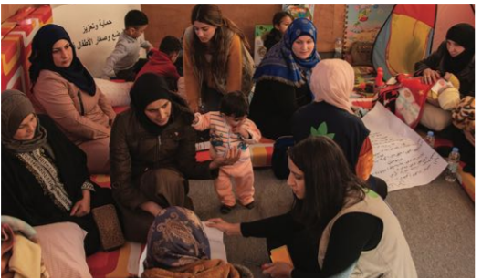
Non-technical supportive actions
Provide privacy and space to breastfeed
Baby Friendly Space in Arsal, Lebanon in 2020.
Joelie Asaf, Action Against Hunger
Arrival/ Registration Centers
Waiting Areas
Health Facilities
Distribution Points
Notes:
Ask: "Why would we want to provide privacy and space to breastfeed?"
Talking Points:
In many cultures, privacy is required for a woman to breastfeed, and in many other cultures it is preferred.
If there are busy, chaotic environments, this is not inducive for breastfeeding.
A quiet, relaxed space will support a mother to adequately breastfed her infant.
Ask: Where may we want to consider setting up a private space for mothers to breastfeed?

Slide 32
Non-technical supportive actions
Enable access to adequate and safe foods for children 6-23 months and PLW
Nutrition
FSL
Counselling
Education on adequate feeding / nutrition
NFI
Suitable foods
Vouchers/ Cash
Diverse foods
Fuel
Cooking equipment
Assistive products for children with disabilities e.g. adapted cups or utensils
WASH
Soap
Water
Food hygiene
Notes:
Facilitator guides participants with:
Complementary feeding is central to the nutritional status and health of children under 2 years during a critical period of development.
Ensuring adequate and safe complementary feeding and maternal nutrition is a multi-sector responsibility.
From 6-months, children need access to nutrient-dense culturally appropriate locally available complementary foods
Foods need to be suitable for children: digestable, nutritious, affordable.
But it's not just about access to suitable foods themselves, families also need to have access to cooking facilities, they need to be able to prepare food safely and hygienically, they need to be able to safely store food.
Ask: "With this in mind, which sectors do you think have a responsible role to play in enabling access to safe complementary foods?"
After responses click to reveal slide contents.
Talking Points:
FSL: a critical role to play in supporting improved and sustained access to suitable foods
Nutrition: education for caregivers on adequate feeding practices e.g. utilization, diversity, frequency, hygiene, continued breastfeeding. Technical support to caregivers experiencing feeding challenges through counselling.
WASH: ensuring adequate food hygiene is crucial in reducing the risk of contaminated foods and subsequent illness, to be able to practice this households need access to soap, sufficient water and information on food hygiene.
NFI: It’s not just about ensuring access to the food itself, but also the equipment and facilities to be able to cook food, and in a safe and hygienic way.

Slide 33
Non-technical supportive actions
Disseminate standardised, clear and accurate messages on IYCF-E
The right message,
at the right time,
from the right person,
to the right person
Notes:
Talking Points:
The right message:
Appropriate communication, clear messages, addressing the relevant, contextual problem on IYCF, identifying solutions.
Based on assessment of practices and needs
Relevant and reflect specific context; address current issues.
In language that the user understands. For example, the language you use for an adolescent mother should be different than the language you use for an older mother.
The right time:
Messages should also be delivered at the right time for the child e.g. age appropriate – deliver messages on complementary feeding when an infant is nearing 6 months of age, deliver messages on early initiation of breastfeeding in the last trimester of pregnancy
From the right person:
Messages should come from a trusted and trained person
Dissemination channels could include: registration and distribution points, community/religious meetings, ‘safe spaces’, at health/child-protection service sites, during household assessments, during distributions, etc.
To the right person:
Mothers, caregivers and the community are key targets for communication and key messages on IYCF-E that reinforce safe and appropriate IYCF-E.
Informing and engaging influential people in the community like grandparents, local leaders and religious leaders about safe and appropriate infant and young child feeding will help broaden the scope of support to mothers and caregivers.
Messages should be targeted to various audience: affected population, media, humanitarian agencies, and other key stakeholders.
Sectoral/cluster coordination should develop standard priority messaging, ensuring consistency.
Clear and consistent IYCF-E messages that reinforce safe and appropriate IYCF-E and address any specific concerns can have a large impact due to their potential reach
All messaging should be available (ideally) in multiple modes i.e. visual & oral/auditory to improve accessibility for caregivers/mothers with disabilities
All messages should be in the appropriate language, understood by illiterate populations, as relevant
For more on this, see: CDC (2018). Crisis and Emergency Risk Communication Manual. https://emergency.cdc.gov/cerc/manual/index.asp
"Communicate effectively about IYCF-E. The right message at the right time from the right person can save lives. To be effective it is important to be first, be right, be credible, express empathy, promote action and show respect. Among others, audiences include emergency-affected communities and their leaders, emergency responders and public health officials and the media."

Slide 34
Why is a Multisectoral Approach Important?
Conceptual Framework
Notes:
Source: Conceptual Framework of Actions for Optimum Fetal and Child Growth and Nutrition. Lancet Maternal and Child Health Series
SAY:
Infant and young child malnutrition and death is not just caused by disease and lack of food. Food insecurity, poor WASH and inadequate care are underlying causes. Lack of political commitment, inadequate education and poor infrastructure are some of the basic causes. Therefore, in order to address IYCF, we need to embrace a multisectoral approach in our work and thinking. This is actually the causal framework of malnutrition, which helps to understand the need and importance of integrating IYCF with other sectors.
Can you relate it to your sector? Let somebody answer.
What can be some potential benefits of integration of IYCF-E with other sectors?
SAY:
Increased impact and reach
Efficiency and cost-effective use of resources
Synergy and complementarity of services
Accountability to beneficiaries

Slide 35
What can We Do?
Group Activity Instructions: Conceptual Framework Scenarios
Divide in Groups. Two different emergency scenarios will be displayed onscreen, one after the other. Ten minutes will be given for each scenario to the groups, followed by five minutes of discussion among all participants for each scenario. Each group should nominate a person to present. All participants will be able to respond during the discussion time.
Each group has to fit the ‘examples of risks’ cut-outs into the Causal Pathway for Undernutrition for each scenario, keeping the following questions in mind:
How might this conflict affect the feeding practices?
How might the environment make poor feeding practices more risky?

Slide 36
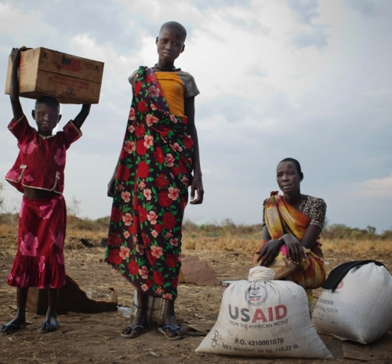
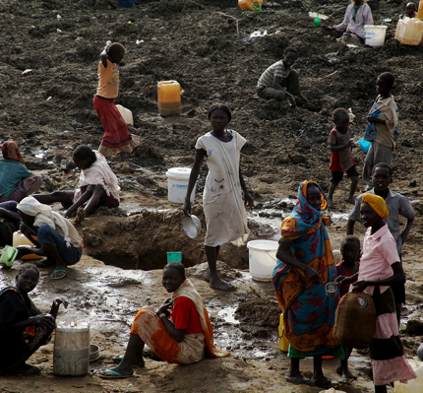
SOUTH SUDAN CONFLICT – January 2014
Notes:
South Sudan Conflict – January 2014

Slide 37
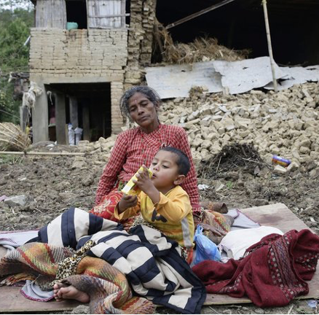
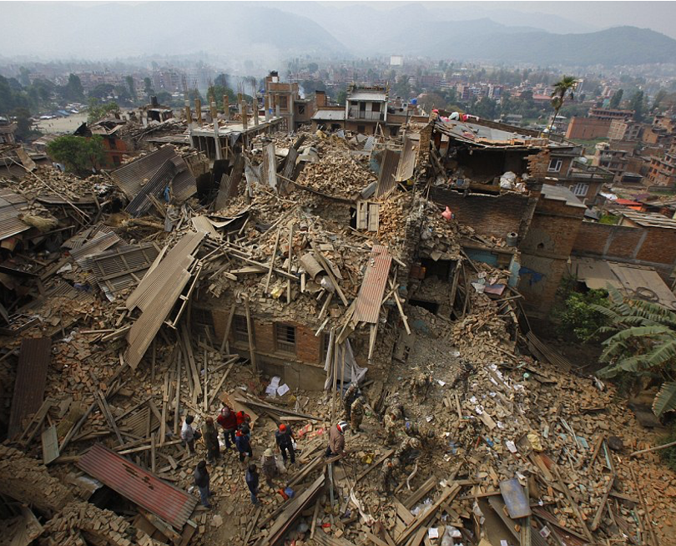
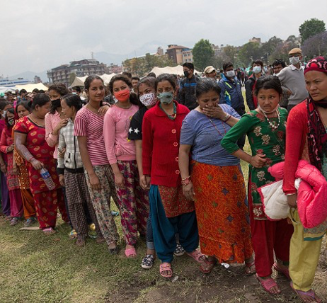
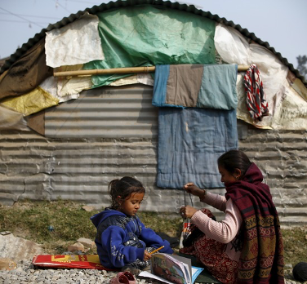
NEPAL EARTHQUAKE – April 2015
Notes:
Nepal Earthquake – April 2015

Slide 38
How can We Do It?
Notes:
SAY:
How can we do it? This is where YOU come in!

Slide 39
How can We Do It?
IYCF Framework: A Multi-sectoral Framework for Action
Notes:
SAY:
The “IYCF Framework: A Multi-Sectoral Framework for Action” is a tool for UNHCR and partners, which has been designed for national and international staff working in refugee operations to provide guidance to managers and technical staff across all sectors on what
needs to be considered to create an ‘infant and young child friendly’ environment and facilitate optimal IYCF. This Framework encourages different sectors to have IYCF champions. The Framework specifically encourages protection of PLW, infants and young children through multi-sectoral integration of IYCF-sensitive activities by taking advantage of all contact points with PLW, infants, young children and caregivers.

Slide 40
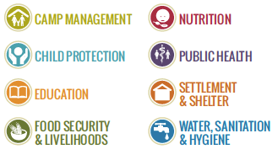
IYCF Framework: A Multi-Sectoral Framework for Action by UNHCR and Save the Children
The different Sectors and the Framework
The Framework is applicable to all sectors
The mother and baby in the Framework are the principle focus
Notes:
The Framework is applicable to all sectors:
Camp management,
Child protection,
Education,
Food security and livelihoods,
Nutrition,
Public health,
Settlement and shelter,
Water, sanitation and hygiene (WASH)
The mother and baby in the Framework are the principle focus. They are supported by the community they live in which closely affects IYCF practices. The circle around them represents high level actions to consider such as advocacy, resource mobilization, and adherence to policies and guidelines. A coordinated effort between all sectors and IYCF ensures protection of rights of children up to 2 years and PLW. Monitoring, evaluation, accountability and learning (MEAL) ensure quality.

Slide 41
IYCF Framework: A Multi-sectoral Framework for Action
Action 1: Advocate for relevant stakeholders to consider IYCF
Action 2: Mobilize resources for IYCF
Action 3: Endorse key policies and adhere to operational standards
Action 4: Select appropriate IYCF activities
Action 5: Integrate IYCF with other sectors
Action 6: Coordinate IYCF-sensitive activities
Action 7: Implement monitoring, evaluation, accountability and learning
Notes:
SAY:
The ‘IYCF Framework: A Multi-Sectoral Framework for Action’ is a tool for UNHCR and partners, which has been designed for national and international staff working in refugee operations to provide guidance to managers and technical staff across all sectors on what needs to be considered to create an ‘infant and young child friendly’ environment and facilitate optimal IYCF. It can be used for emergency situations with or without refugees and can be adapted to situations other than emergencies. Key activities and over-arching opportunities for integration provide various ways in which each sector: camp management, FSL, WASH, Education, Child Protection, other nutrition programmes, Public health, settlement and shelter; can integrate IYCF into their programming.
The mother and baby in the Framework are the principle focus. They are supported by the community they live in which closely affects IYCF practices. The circle around them represents high level actions to consider such as advocacy, resource mobilization, and adherence to policies and guidelines. A coordinated effort between all sectors and IYCF ensures protection of rights of children up to 2 years and PLW. Monitoring, evaluation, accountability and learning (MEAL) ensure quality. The Framework has chapters on each sector, which includes examples of key integrated activities. The two-pagers for each sector will help succinctly elaborate that.
Common strategic objectives
Key integrated activities
Overarching opportunities for collaboration
Resources

Slide 42
How can We Do It?
Who is an IYCF Champion?
Support and Advocate for IYCF
Coordinate at the early stages of emergency
Maintain knowledge
Follow-up on activities
From any sector
Any level of organization
IYCF experience not necessary
Trained on fundamentals of IYCF and cognizant of risks identified for PLW and IYC.
Well respected among beneficiaries
Notes:
SAY:
Who can be an IYCF Champion?
Someone willing to advocate for the needs of PLW, infants and young children
Staff from any sector, with or without IYCF experience
Staff from any level of the organization (i.e. a manager, a member of field staff etc.)
Someone with good interpersonal skills; role models and respected by the beneficiaries
As many as possible; one nutrition or IYCF staff can identify and orientate several champions according to the context and buy-in from actors

Slide 43
How can We Do It?
What does an IYCF Champion do?
Advocate
Lead
Coordinate
Fundraising and strategy involvement
Context Analysis
Identify risks and needs
Integrate
Know Priorities of other sectors
Monitoring
Notes:
SAY:
An IYCF Champion:
Advocates and supports IYCF.
Takes a lead in the IYCF-E response through existing mechanisms. Considers IYCF in their daily activities
Actively participates in different strategic coordination mechanisms (multi-sectoral and sector specific if relevant) to ensure IYCF is considered in decision making processes
Actively involves in fundraising for IYCF when multi-sectoral strategies and proposals are being developed
Participates in context analysis at the onset of an emergency, providing information where relevant
Identifies risks and needs for PLW and children 0-23 months in their line of work
Identifies opportunities for integration and brainstorm activities to put in place with other sectors
Meet bilaterally with other sector colleagues where possible and Informs and keeps informed about priorities of relevant sectors
Participates in monitoring of IYCF Framework where requested

Slide 44
How can We Do It?
What does an IYCF Champion need to know?
Why PLW and children under two
What the needs are
What IYCF is
What risks are identified for PLW and children under two
What the priorities are for other sectors
Notes:
SAY:
What should an IYCF Champion Know?
Why PLW and children 0-23 months are vulnerable and should be prioritised
What the needs are of PLW and children 0-23 months
What IYCF is in relation to feeding and care practices
What risks are identified for PLW and children 0-23 months in an emergency (consequences of the situation)
What the priorities are of other sectors

Slide 45
How can We Do It?
Ways to Advocate
All staff meetings/Awareness sessions, Internal announcements/five year plans/Strategies
Sector meetings/Coordination meetings/Working group meetings/Technical forums/Seminars/Bilateral meetings/Sector leads
Home visit records/Joint visits
IEC material
Social media/Media/Medical Associations
Demonstrate
Special Events
Carry forward
Notes:
SAY:
Within the organization, you can advocate for integration of IYCF by bringing up its importance and integration opportunities in all staff meetings or hold awareness sessions about it or make internal announcements. Include IYCF in the organization’s five year etc. plans and strategies.
With stakeholders outside your organization, you can introduce it during sector meetings or coordination meetings or working group meetings or technical forums or seminars or discuss it bilaterally. Hold meetings with sector leads.
You can visit homes of target groups in your sector and make notes on how the individual’s situation is being affected by IYCF and vice versa. Conduct joint visits with the sector personnel.
You can distribute IEC material such as fact sheets, flyers, pictures, IYCF policies, joint statements etc.
Create a buzz on social media about it. Train or give interviews to journalists or offer site visits. Engage with medical associations.
Demonstrate how integration helps in achieving higher impact and cost effectiveness. Demonstrate that how appropriate IYCF is a child’s right and how it fits with the national/organizational priorities.
Have IYCF on the agenda on special events or days or activities. E.g. walk for a cause, breastfeeding week, launching ceremonies etc.
Hold similar champions training to carry forward the torch. Give away appreciation awards or certificates to celebrate achievement.

Slide 46
How can We Do It?
Ways to Mobilize Resources
All staff meetings
Sector meetings/Coordination meetings/Working group meetings/Technical forums/Seminars/Bilateral meetings
Meetings with donors
Calls for proposals
Demonstrate results
Special Events
Notes:
All staff meetings
Sector meetings/Coordination meetings/Working group meetings/Technical forums/Seminars/Bilateral meetings
Meetings with donors
Calls for proposals
Demonstrate results
Special Events

Slide 47
How can We Do It?
Ways to Endorse Key Policies
All staff meetings/Awareness sessions, Internal announcements/five year plans/Strategies
Sector meetings/Coordination meetings/Working group meetings/Technical forums/Seminars/Bilateral meetings/Sector leads
Orientations, trainings, refresher trainings
Monitoring
Demonstrate
Special Events
Notes:
All staff meetings
Sector meetings/Coordination meetings/Working group meetings/Technical forums/Seminars/Bilateral meetings
Meetings with donors
Calls for proposals
Demonstrate results
Special Events

Slide 48
How can We Do It?
Ways to Integrate IYCF with Other Sectors
Incorporate IYCF messaging in other sectoral activities
Prioritize pregnant women and caregivers with children <2 years in access for services across sectors
Include sectoral staff in IYCF trainings and vice versa
Targeted food programs for vulnerable groups, including PLW, <2 years
Integrate maternal nutrition and breastfeeding promotion in ANC/PNC
Others? What are some ways you can think of?
Notes:
Incorporate IYCF messaging in other sectoral activities
Prioritize pregnant women and caregivers with children <2 years in access for services across sectors
Include sectoral staff in IYCF trainings and vice versa
Targeted food programs for vulnerable groups, including PLW, <2 years
Integrate maternal nutrition and breastfeeding promotion in ANC/PNC
Others? What are some ways you can think of?

Slide 49
How can We Do It?
Ways to Implement Monitoring, Evaluation, and Learning
Quarterly reviews
Annual reviews
Assessments, surveys
Case studies, sharing lessons learned
Cross-sectoral learning
Notes:
Quarterly reviews
Annual reviews
Assessments, surveys
Case studies, sharing lessons learned
Cross-sectoral learning

Slide 50
Recap and Close
Training Objectives
Do you think you:
Understand why IYCF(E) is important?
Know the recommended IYCF practices?
Understand that integration of IYCF in different sectors is crucial due to multisectoral causes of malnutrition?
Understand how you can support IYCF and take action as an IYCF champion?
Notes:
SAY:
Let us go over each objectives to see that if you are fully satisfied in having achieved todays objectives.
DO:
Go over the session objectives and ask participants if they think these objectives have been reached.
SAY:
What are the key things you have taken from this training and in what ways will they be useful?

Slide 51
THANK YOU

